Slide 1
Medical and Non-Medical Care Integrated through Artificial Intelligence to Optimize Self-Management of Health
Piali De, PhD
Co-founder & CEO

Slide 2
Our healthcare system is ill-equipped to support healthy aging
We all know that the US healthcare system does not work well for longitudinal care because the system is highly fragmented and compartmentalized
De-fragmentation is critically needed and is only possible through integration of people, processes and data
Senscio Systems’ Ibis Program uses a powerful artificial intelligence platform to integrate care for those with the most complex health

Slide 3
Now is the time
CMS and State Governments feel the economic urgency of the dually eligible population and are seeking innovative solutions
Medicare is gradually increasing payments for the management of complex health.
  Current Medicare fees pay an average of $3,000/individual annually
Health plans are increasingly willing to pay care management fees for this population - ”Value Based Payments”
CMS is promoting integration of care services and as of 2019 is actively soliciting state Medicaid agencies to:
  Propose new ways of integrating care and coordinating services for the dually eligible population
  Improve quality of patient care and reduce costs for federal and state governments
  A “Capitated Shared Savings” approach
We are a right place / right time solution that is no accident

Slide 4
Our IbisTM Program horizontally integrates every aspect of care – driven and managed by Senscio’s powerful AI engine

Slide 5
Our IbisTM Program horizontally integrates every aspect of care – driven and managed by Senscio’s powerful AI engine
Coordination
Self-management support services are delivered though Medical practices with a public health focus on patient education and prevention of secondary complications.

Slide 6
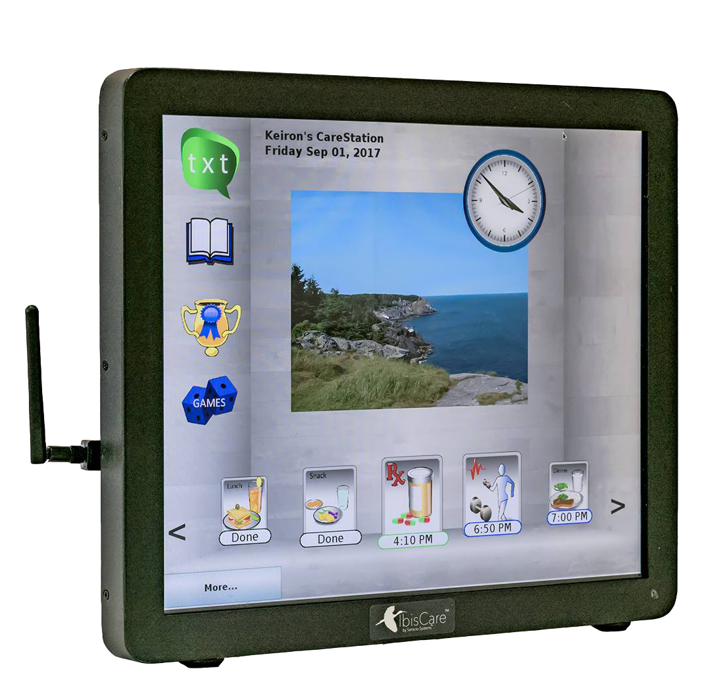
Easy to use member interface that invites interactions – we achieve a remarkable 80% compliance with members
IbisHub is our member’s command center through which individuals receive guidance for self-care and can request support
Daily reminders:
Medications
Meals
Physical activity
Vitals and symptoms checks
Appointments
Activities of daily living
Instructions for self-recovery of health (if needed) for:
COPD flareup
CHF fluid retention
Episodic hypertension
Hypoglycemia
Hyperglycemia
Chronic depression

Slide 7




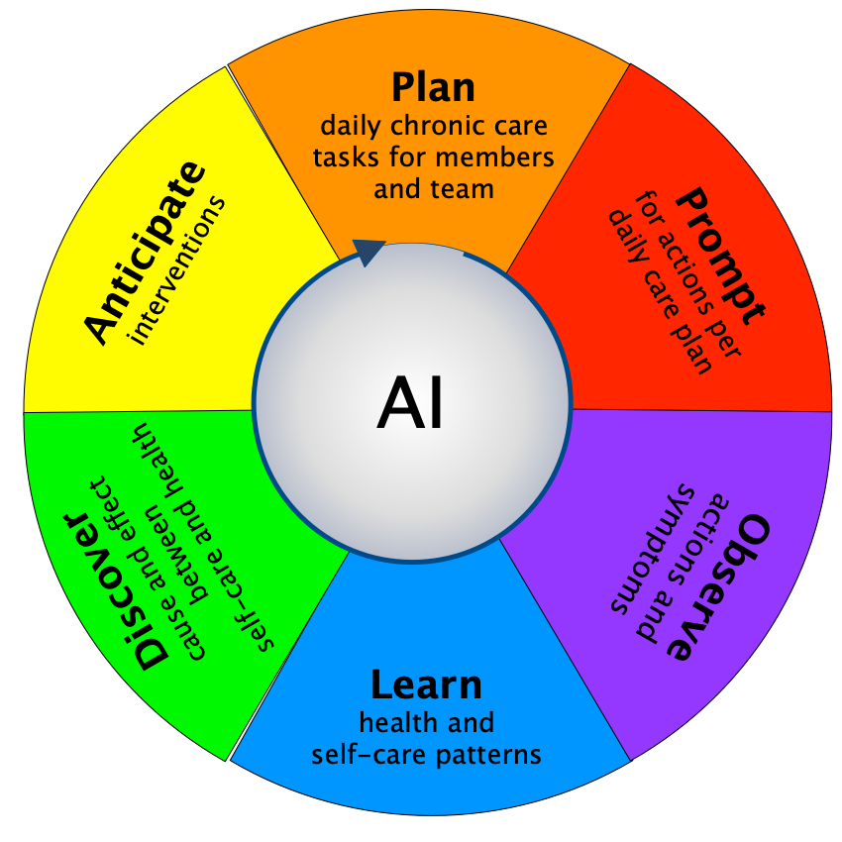
Data is collected from multiple sources, interpreted by the AI and turned into plans and actions
Simple API incorporates 3rd party data
IbisHub
Engages member in
self-management and collects data on actions taken
Biometric Devices
actively or passively collect data
Wearable Sensors
tracks and learns routines
IbisNexus
incorporates providers actions
Plans are dynamically adjusted based on what is observed and learned in real time
Data includes:
Physicians
Pharmacy
Health telemetry
Physical telemetry
Social activity
Dietary activity
Mental activity

Slide 8
Better experience of care
Better than 80% average adherence to prescribed care plan to date
98% of patient members would recommend Ibis to others
90% of health deteriorations are detected by the AI and treated at home
70% of health deteriorations are corrected through self-rescue measures
Outstanding results
Multi-year studies performed on select (COPD) and assisted living patient populations in Maine
Lower cost outcomes
73% fewer hospitalizations (all causes) and 78% lower COPD related hospitalizations per patient per year, zero readmissions
Mean time between hospitalization increased from 209 to 1003 days
81% increase in end-of-life happening in community dwelling
Median age of assisted living facility residents increased from 84 to 86 years over a 3 year period
36% fewer transitions to nursing home
Case management capacity is tripled

Slide 9
Now
Only though integration can we leverage efficacies to meaningfully reduce cost and improve health
Senscio’s model is to share in a portion of that cost savings
Medicare Fee-for-Service
1
$
Senscio Systems
Cost Reductions
Self-Management Support
Ibis Program
Members
Network Partners
Data
Uncoordinated Services
Member acquisition occurs through network partners and payer referrals
As the integrator, Senscio earns the care management fees
We make payments, including a portion of bonus payments, to network partners who provide a majority of the high touch services
  In our three launch states we have 55 partners across all necessary disciplines
We profit from driving efficiencies and improving care

Slide 10
Now
Only though integration can we leverage efficacies to meaningfully reduce cost and improve health
Senscio’s model is to share in a portion of that cost savings
Medicare Fee-for-Service
1
$
Senscio Systems
Cost Reductions
$ Fee-for-Service share
1
Self-Management Support
Ibis Program
Guidance
Members
Network Partners
Data
Data
Directed Services
Member acquisition occurs through network partners and payer referrals
As the integrator, Senscio earns the care management fees
We make payments, including a portion of bonus payments, to network partners who provide a majority of the high touch services
  In our three launch states we have 55 partners across all necessary disciplines
We profit from driving efficiencies and improving care

Slide 11
+
Now
2020
Medicare Fee-for-Service
Supplemental Fees or Bonus Payments
Only though integration can we leverage efficacies to meaningfully reduce cost and improve health
Senscio’s model is to share in a portion of that cost savings
1
2
$
$
Senscio Systems
Cost Reductions
$ Supplemental Fees share
2
$ Fee-for-Service share
1
Self-Management Support
Ibis Program
Guidance
Members
Network Partners
Data
Data
Directed Services
Member acquisition occurs through network partners and payer referrals
As the integrator, Senscio earns the care management fees
We make payments, including a portion of bonus payments, to network partners who provide a majority of the high touch services
  In our three launch states we have 55 partners across all necessary disciplines
We profit from driving efficiencies and improving care

Slide 12
+
+
Now
2020
2021
Medicare Fee-for-Service
Supplemental Fees or Bonus Payments
Shared Savings or Capitated Payments
Only though integration can we leverage efficacies to meaningfully reduce cost and improve health
Senscio’s model is to share in a portion of that cost savings
1
2
3
$
$
$
$ Savings Share
Senscio Systems
3
Cost Reductions
$ Supplemental Fees share
2
$ Fee-for-Service share
1
Self-Management Support
Ibis Program
Guidance
Members
Network Partners
Data
Data
Directed Services
Member acquisition occurs through network partners and payer referrals
As the integrator, Senscio earns the care management fees
We make payments, including a portion of bonus payments, to network partners who provide a majority of the high touch services
  In our three launch states we have 55 partners across all necessary disciplines
We profit from driving efficiencies and improving care

Slide 13
The path to healing our healthcare system is clear and has begun
Healing our healthcare system requires integrated care
Integrated care is person-centered
Integrated care is possible today
  Revenues, people infrastructure, and technology are all available, waiting for us to apply it

Slide 14
Thank You
Piali De, PhD
Co-founder & CEO
(617) 834-2853
piali@sensciosystems.com

