Slide 1
Information Communication Technology for Aging-in-Place
Sajay Arthanat, PhD., OTR/L., ATP
Associate Professor
Dept of Occupational Therapy
University of New Hampshire

Slide 2
Scope OF ICT for Aging-in-PLace
Facilitating Social Connectedness
Reducing Social Isolation and Depression
Health Management
Leisure
Promoting Independent and Community Living Skills

Slide 3
Addressing the Digital Divide

Slide 4
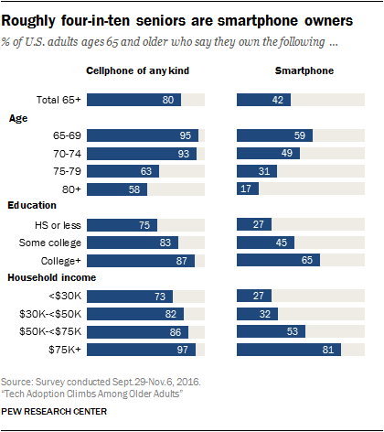
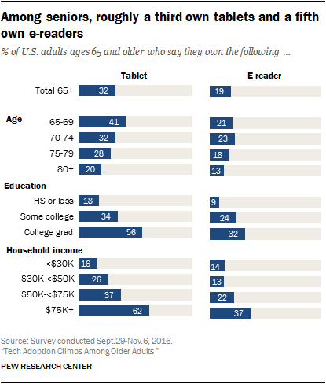
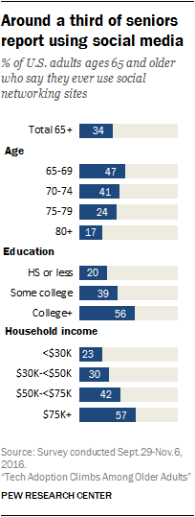
Addressing the Digital Divide

Slide 5
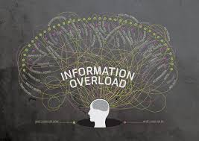
The Digital Paradox
Three phases
What you don’t know you don’t know
What you know
you don’t know
What you want to know
What you don’t want to know more about

Slide 6
Common factors associated with digital divide
____Awareness of the technology (You don’t know what you don’t know)
____Knowledge on use of the technology (Have not used something like this)
____Confidence to learn the technology (It is going to be too hard and complicated)
____Fear and anxiety (What if I break it?)
____Operational skills (I have poor vision and eye-hand coordination to use this)
____ Financial resources (Too costly for me to afford)
____Interest or motivation to use the technology (Why should I have this?)
____ Awareness of the benefits of the technology (What would I benefit from this?)
____ Scope or need for the technology to age-in-place (How is this going to help me age at home?)
____Influence of family and friends (Grandma / Grandpa is not going to use it anyway)

Slide 7
Individualized Community and Home-based Technology Training (i-CHATT)
One-on-one
Home-based
Individualized
Inter-generational
For more information: https://ichatt.unh.edu/
Funding from the National Institute of Aging [National Institute of Health]
Academic Research Enhancement Award# 1R15AG044807-01A1

Slide 8
Training Protocol
3-Month Training Program
Participant paired with a student coach
Orientation session and an activity priority list completed
Long term goals (activity-based) and short-term goals (skill-based and application-based) chosen
Student coaches conduct 3 home visits
Teach basic features and functions
Review and download iPad applications in accordance to priority checklist
Monitor progress with goals
Address ongoing questions and concerns
Scheduled check-ins
For reference: Arthanat, S., Vroman, K., & Lysack C. (2014). A Home-Based Individualized Information Communication Technology Training Program for Older Adults: A Demonstration of Effectiveness and Value. Disability and Rehabilitation: Assistive Technology, 16, 1-9

Slide 9
Case Study
AM, 76-years of age, lives with her husband. She worked as a medical secretary and “is good with numbers,” but had no experience with computers at work. She has used a laptop for the past 7 years as wells as owns a tablet and Smart phone. AM uses email, text messages, and Facebook to communicate. She “lacks enough knowledge and does not find her technologies to be people friendly.” She has broadband WiFi at home, but uses the Internet minimally due to fear of being hacked.
Online training database: https://ichatt.unh.edu/

Slide 10
AM’s Training Protocol
Background information
Occupational Performance / Activity Checklist
Recommendations
Long-term and short-term goals
SOAP Notes
Progress Tracking

Slide 11
Two-year RCT
Participants (65+) who met our at-risk / low profile ICT inclusion criteria
Recruited from various community agencies
Staggered design: N~15 in each training cohort and control group x 3
3-Month ICT Training
Follow-up Data
Randomization
6-Months
1-year
18-Months
2-Years
Baseline
Control Group
2-Year Exploratory Study

Slide 12
Thanks / Questions
For Information:
Sajay.arthanat@unh.edu
Funding from the National Institute of Aging [National Institute of Health]
Academic Research Enhancement Award# 1R15AG044807-01A1

