Slide 1
Welcome to
Today’s Webinar
Power of Planning 2.0
Bringing it Back to Our Communities

Slide 2
Tri-State Learning Collaborative on Aging
Our mission: Increasing the collective impact of aging in place initiatives through shared learning in New Hampshire, Maine & Vermont

Slide 3
Thank you to our Funders!
www.agefriendly.community

Slide 4
Announcements
Next Webinar:
May 29, 2018 | Advocacy Issues on Fire
Spring Summit:
June 20, 2018 | Embracing the Options
Fireside Inn, Lebanon NH
Social Media:
Follow Us on Facebook
(Tri State Learning Collaborative on Aging)

Slide 5
Webinar Housekeeping
Audio issues?
Try calling in using your telephone!
To be unmuted
click here &
virtually raise your hand
Send questions to us by typing them in here.

Slide 6
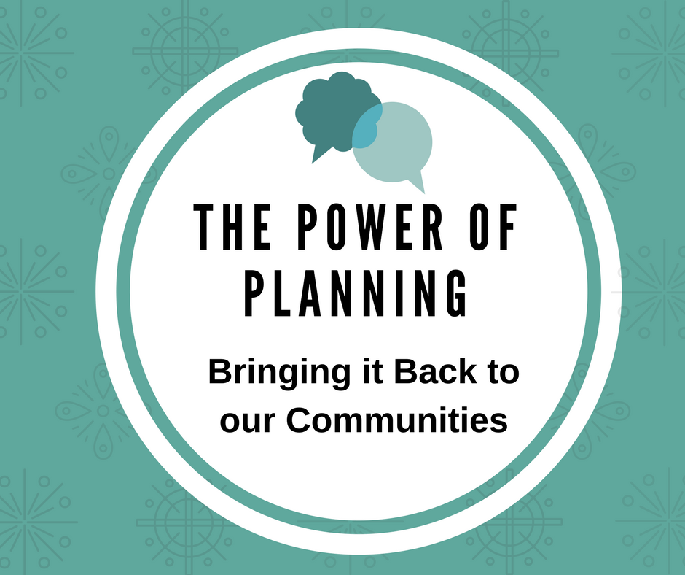
Today’s Webinar
The Power of Planning:
Bringing it Back to Our Communities

Slide 7
Agenda Overview A Range of Tools and Resources - Martha Tecca Implementation in your Community - Bill McPeck Challenges with Implementation - Jane Nyce

Slide 8
Promoting Life Planning - Considerations
Programmatic approaches to the conversation about planning
Group conversations in community
One-to-one conversations “trained”
Encouraging one-to-one and family conversations
Focus of planning
Specific plans (Advance Directives, Financial, EOL)
Broader life planning … what matters most?
Program focus
Embracing one approach/tool
Introducing a variety of tools to spread

Slide 9
Some Tools to Support Planning Conversations
UNH Home and Living Community Guide
https://drive.google.com/open?id=1DCtr7dtR5C5c-9SfjQyeHZfaJbJe-rCi
Tools for Aging with Dignity Course
http://www.unitedvalleyinterfaithproject.org/aging
Conversation guides and games to begin important and meaningful discussions.
http://www.commonpractice.com/
Tools to support having end-of-life discussions.
https://theconversationproject.org/
http://deathoverdinner.org/
http://deathcafe.com/

Slide 10
Implementing Planning Approaches in the Community
How do you get these tools adopted in your community?
Once you get buy in to use the tools, how do you go about having these conversations with the seniors?
Examples, Ideas, Brainstorm, Share

Slide 11
Implementation Challenges and Successes – Sharing
Program implementation challenges?
Challenges with initiating individual conversations?
What are some ways those challenges have been overcome?

Slide 12
Thank You for joining us!
Slides & evaluation will be
sent out later today.
Recorded webinar will available
within 24 hours.
www.agefriendly.community
patriciafkimball@gmail.com

