Slide 1
Y/OUR Role in Creating an Age-Friendly Community
November 28, 2017
Kathy Black, Ph.D.
Professor, University of South Florida, Sarasota-Manatee
Age-Friendly Sarasota Initiative Consultant, The Patterson Foundation

Slide 2
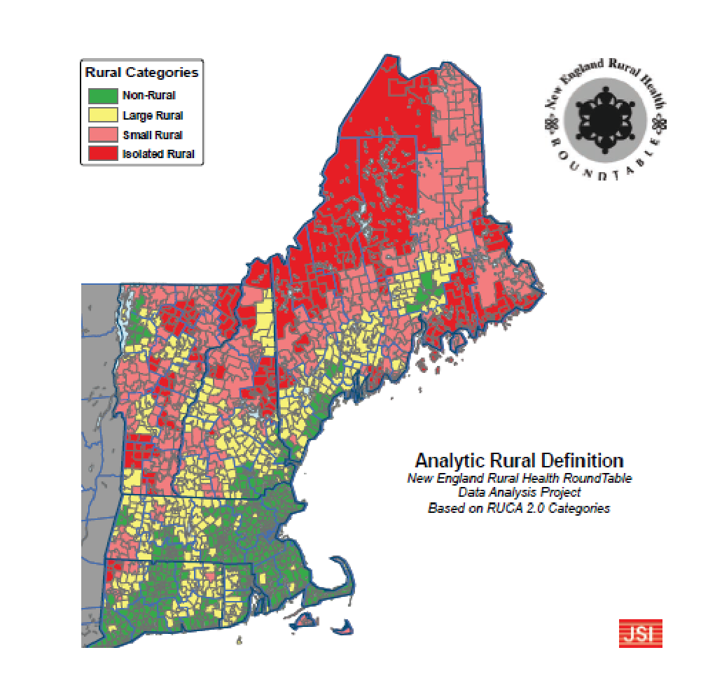
Northern New England
Shared Boundaries, Shared Geography, & Shared Sense of Place
Notes:
Point out that ME, VT and NH not only share borders, but have a shared sense of rurality and shared sense of place and rugged Yankee individualism.
Zip code level

Slide 3
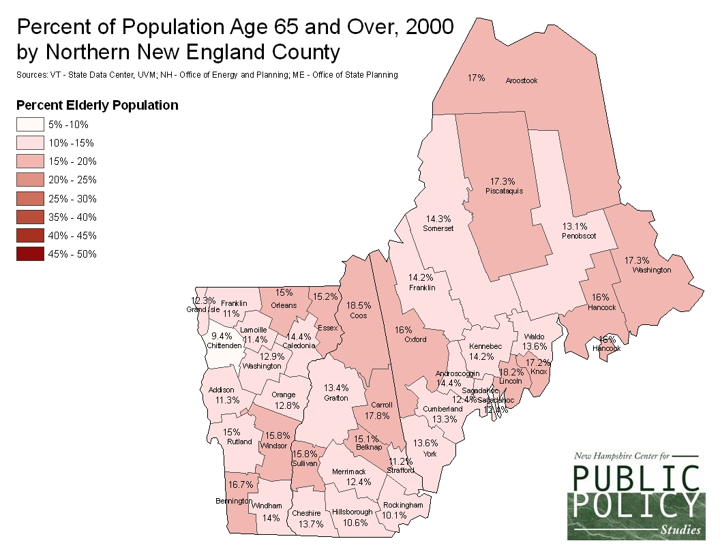
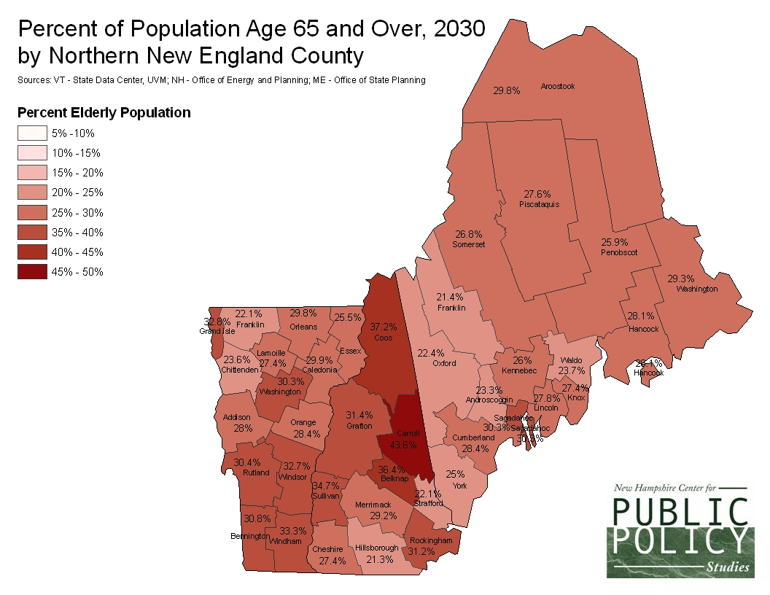
Shared Future in Northern New England
Notes:
ME, NH and VT are the states with oldest median age in the US.
For the country, the median age is 38 years.
At 44.6 years, the median age in Maine is the highest in the nation.
New Hampshire’s median age of 43.0 years is the next highest, followed by Vermont at 42.7 years.
Data from US Census Bureau, June 2017

Slide 4
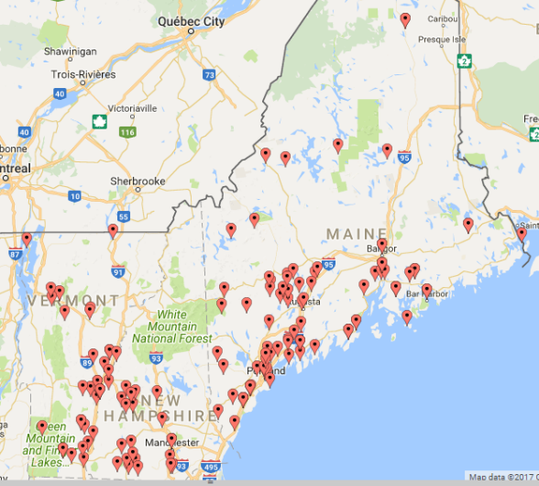
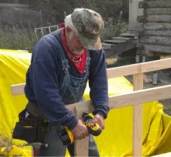
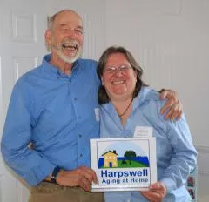
Age-Friendly Communities Across NNE
Notes:
Local efforts are popping up all over the region – this isn’t even all of them!
The TSLCA is a way to connect these locally-grown efforts and help equip volunteers with the skills and information that they need.

Slide 5
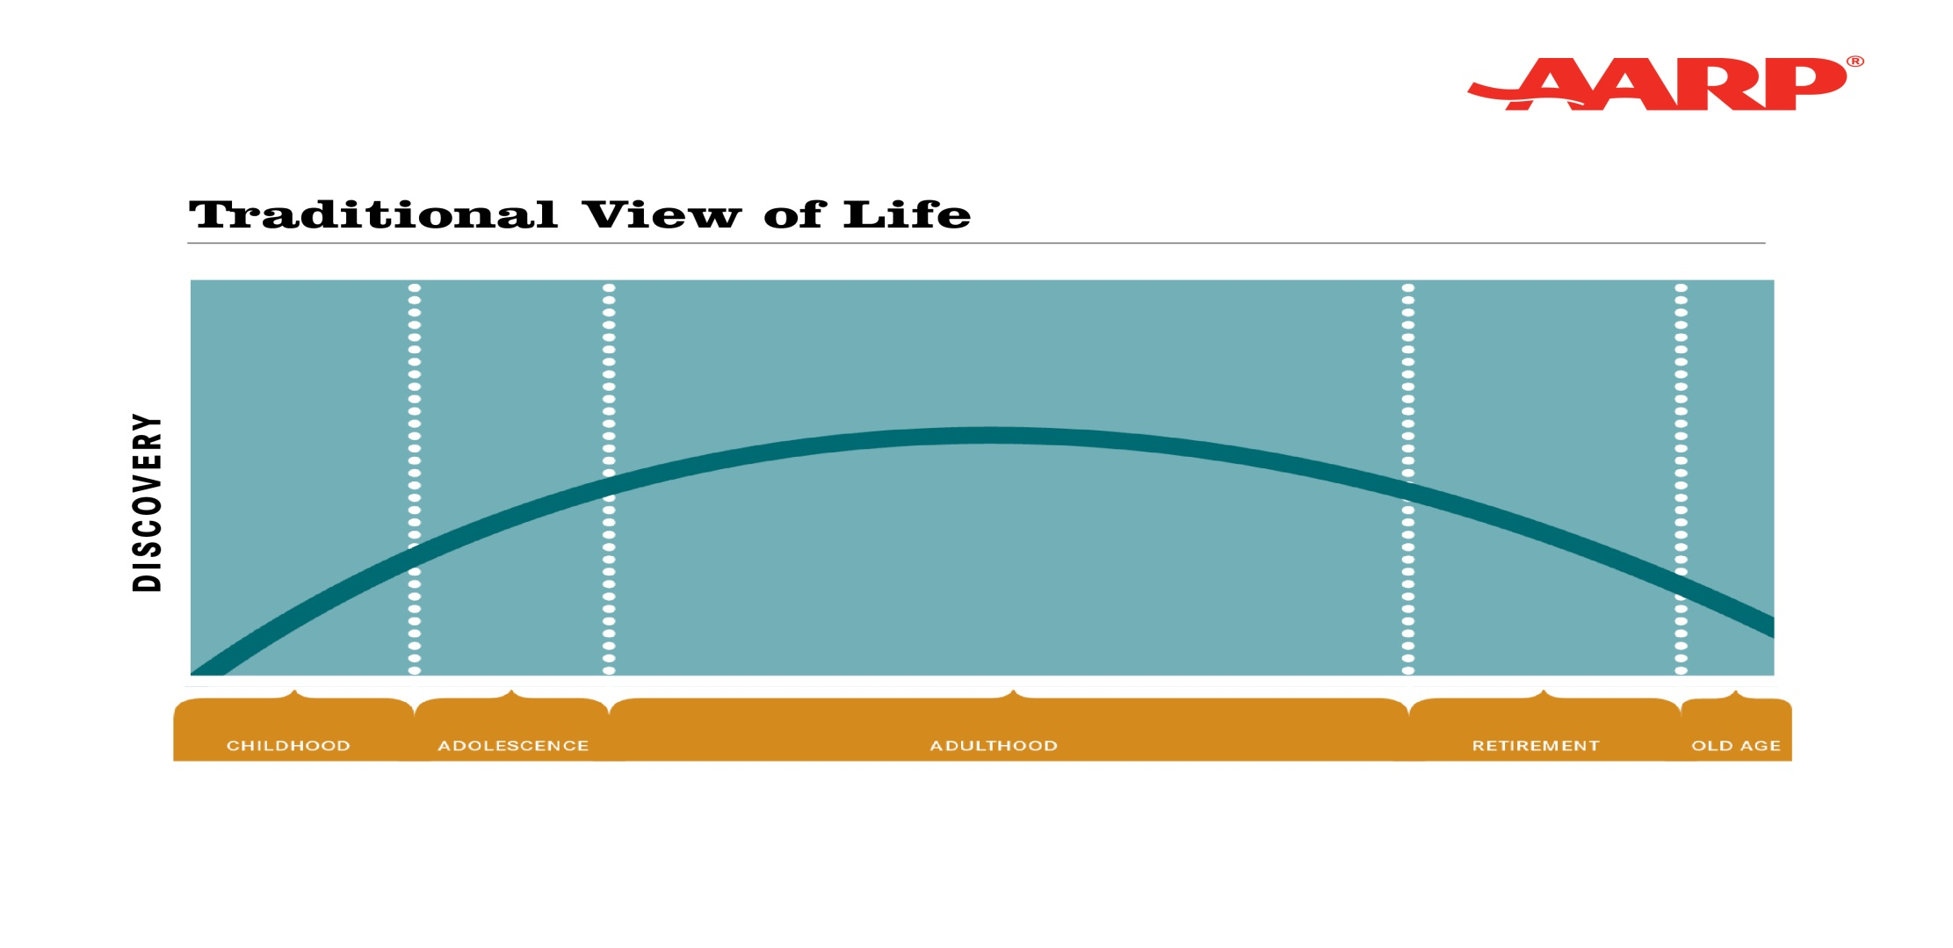
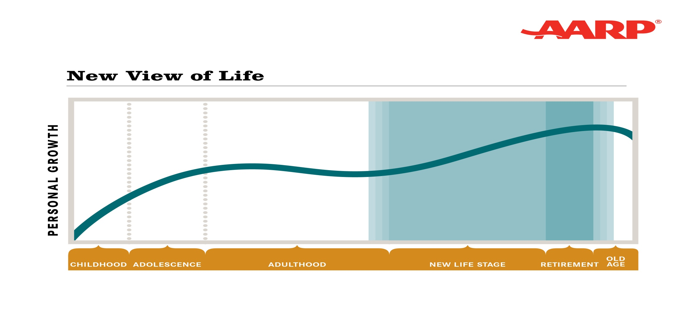
Projected Sarasota County Population Pyramid
5
5
“Longevity changes everything”
Dr. Joe Coughlin, MIT Age Lab
Source: AARP

Slide 6
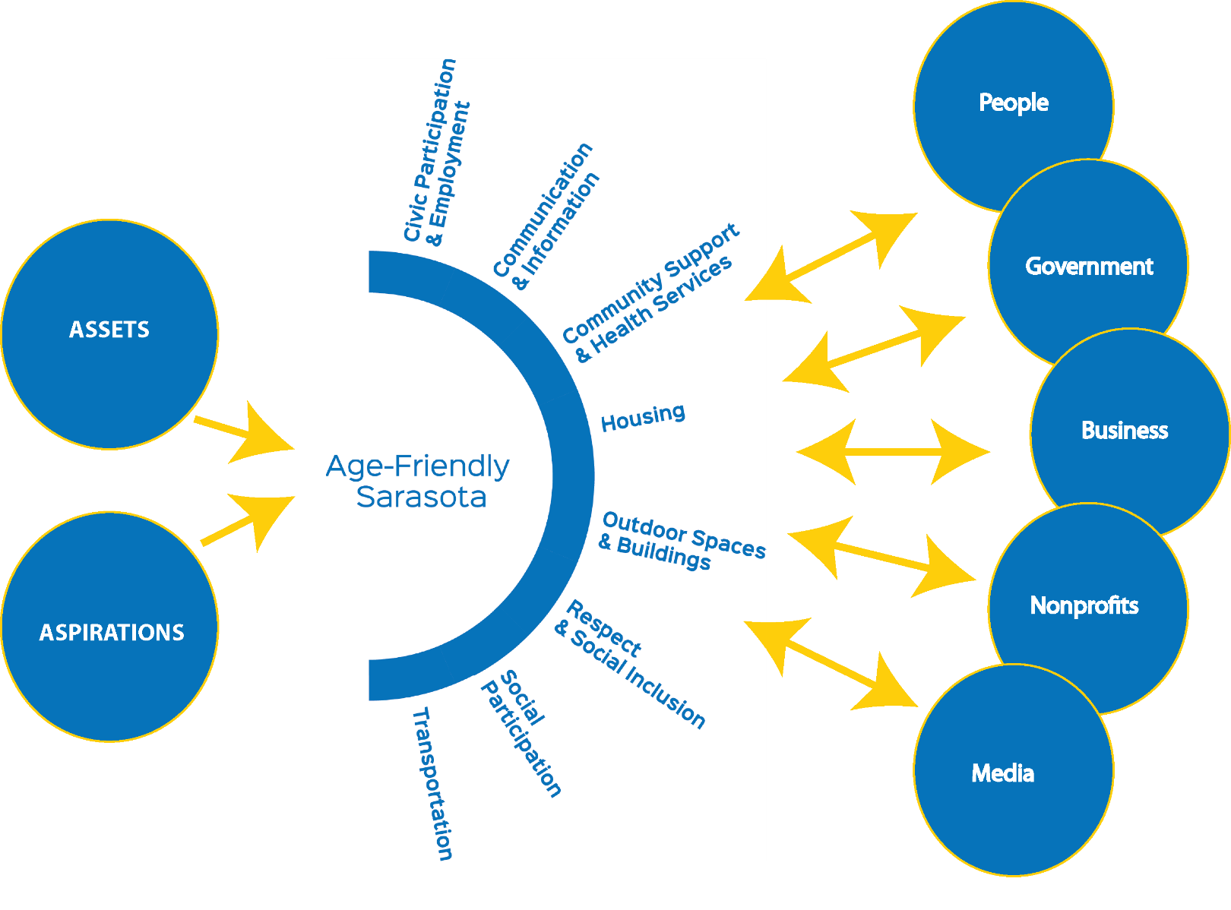
IMPACT
Age-Friendly Community Model

Slide 7
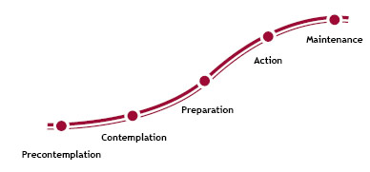
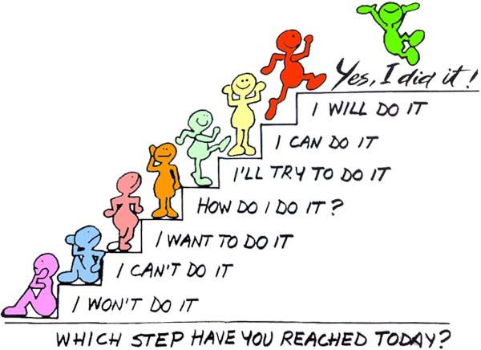
EDUCATE for Change

Slide 8
Take Home Points
Positive possibilities with age
Lead by example
Follow your passion
Reach out & educate others
Intergenerational framing
Everyone is a stakeholder
Personalize aging
Build upon past efforts
Look for opportune alignments
Celebrate successes
Mobilize champions by domain
Have fun!

Slide 9
With much excitement for our collective age-friendly future ahead!
Kblack@sar.usf.edu

