Slide 1
Today’s Webinar
Housing as Community Development

Slide 2
Tri-State Learning Collaborative on Aging
Our mission:
Increasing the collective impact of aging in place initiatives through shared learning.

Slide 3
Thank you to our Funders!
www.agefriendly.community

Slide 4
Upcoming Learning Opportunities
Semi-Annual Summit
Driving Community Home: What Does it Take to Build a Lifetime Community?
Registration Closes Monday!
November 28, 2017
Holiday Inn by the Bay, Portland, ME

Slide 5
Webinar Housekeeping
Audio issues?
Try calling in using your telephone!
To be unmuted
click here &
virtually raise your hand
Send questions to us by typing them in here.

Slide 6
Today’s Webinar
Housing as Community Development
Staying in your community as you age

Slide 7
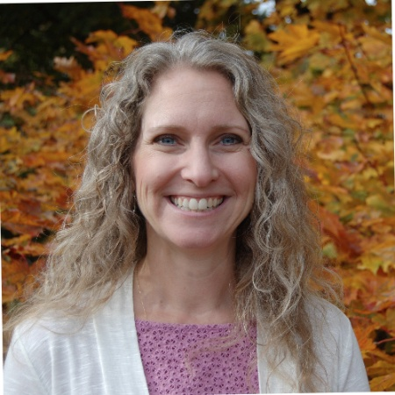
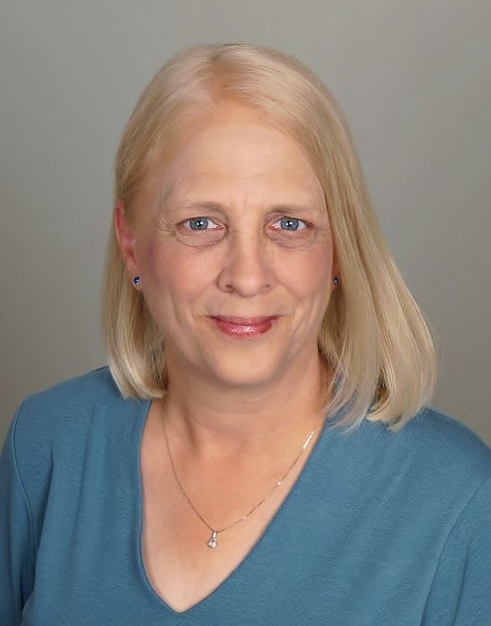
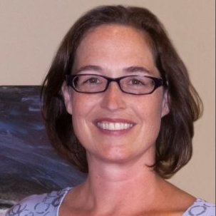
Doug Wilson,
Introducing Today’s Panelists
Panelists
Deb Keller
Executive Director
Bath Housing Authority
Rebecca Dillon
Principal
Gawron Turgeon Architects
Rev. Faith Fowler
Executive Director
Cass Community
Social Services

Slide 8
Tri State Learning Collaborative: Housing as Community Development
November 17, 2017

Slide 9
Bath Housing works to enhance housing stability for seniors, those with disabilities, and families in the greater Bath area. We have four strategic goals:
Improve quality of life for the people we serve through superior customer service.
Increase the supply of affordable housing.
Pursue innovative programs and services to meet affordable housing needs in the region, with a special emphasis on aging-in-place.
Improve the organizational capacity to achieve our mission.

Slide 10
The Call

Slide 11
We want to develop (old school, large old house, vacant lot) into new housing.
What do we need to do?

Slide 12
Examples
Non-profit A has a building it wants to turn into housing
Non-profit B has been offered a free piece of land
Town C has a vacant school
Town D has an old mill
Town E has some big, old houses that could be made into apartments
A committed group of community members want to see senior housing built in their town

Slide 13
Real Estate Development 001

Slide 14
Development Process
Pre-Development
Concept/Market Analysis/Feasibility
Site Selection/Site Plans
Environmental Assessments/Survey
Permitting
Financing
Construction
Plans & Specs
Oversight
Operation
Lease-Up
Property Management

Slide 15
Understanding Real Estate Development
Risk (pre-development)
Risk (construction)
Risk (operational)

Slide 16
Financing
Scarcity of Resources
HUD 202
Public Housing
RD 515
Low Income Housing Tax Credit
Highly Competitive
Award cycle one time/year
Expectation of “readiness” means high pre-development costs
Smart Growth expectations
Private Debt
Difficult to meet affordability targets
Grants
Few funders make capital grants

Slide 17
Still Determined?

Slide 18
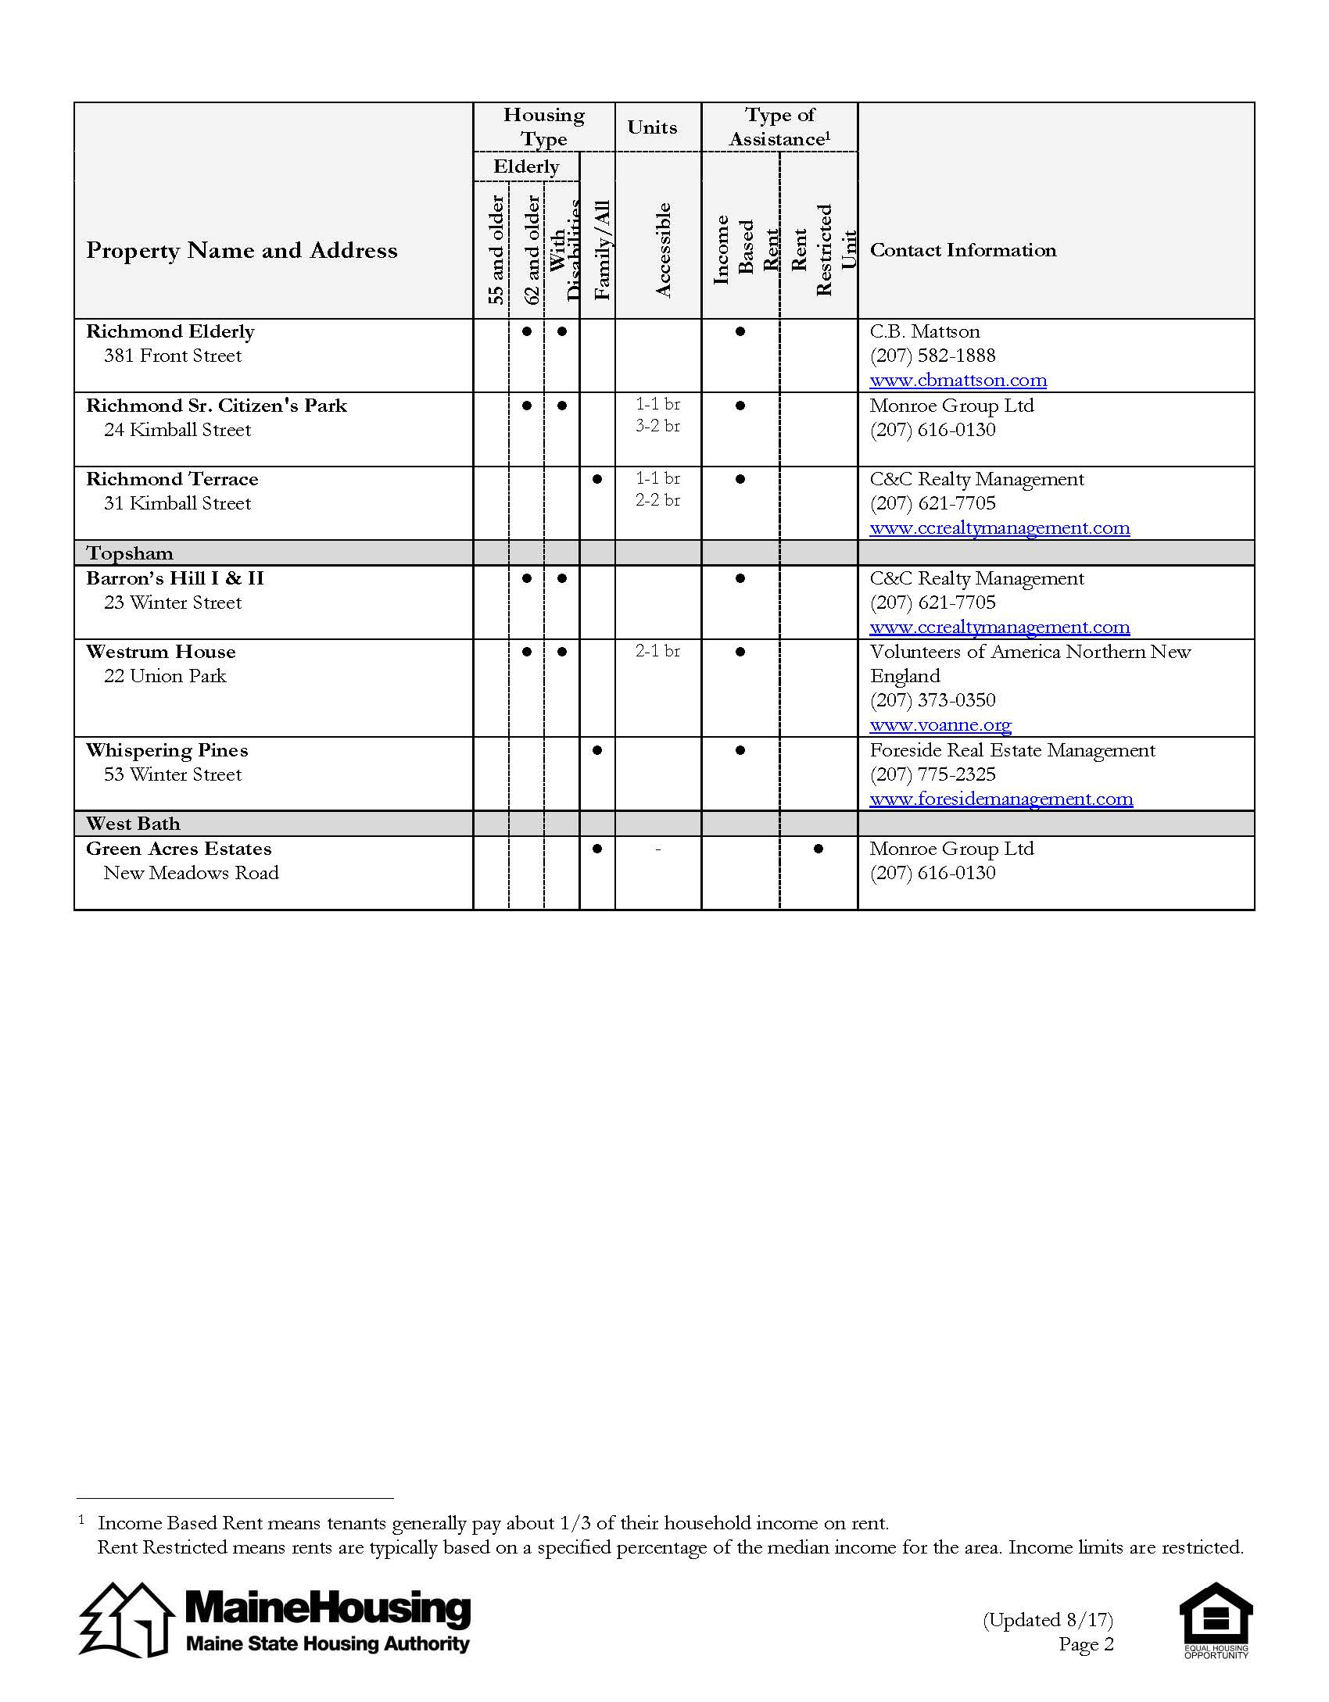
Know Your Market
Review Craigslist, Zillow, Newspaper Ads for market rate listings
Review MaineHousing’s Subsidized Apartment Listings by county:
http://www.mainehousing.org/programs-services/rental/subsidized-housing
Get to know who is serving your area –
Public Housing Authorities
Housing Developers
Consultants

Slide 19
Find a Partner or Consultant
Process requires financial capabilities, access to pre-development capital, ability to guarantee loans, etc.
Need a strong project manager to manage your development team, which includes an attorney, architect, engineers, accountant, etc.
Need staff and team capacity to undertake this effort.
You do not need to go it alone!

Slide 20
Factors in Successful Projects
Committed, determined teams
A champion or two
Flexibility
Patience

Slide 21
DESIGN + SENIOR LIVING
Safety
Age in Place
Maintain Independence

Slide 22
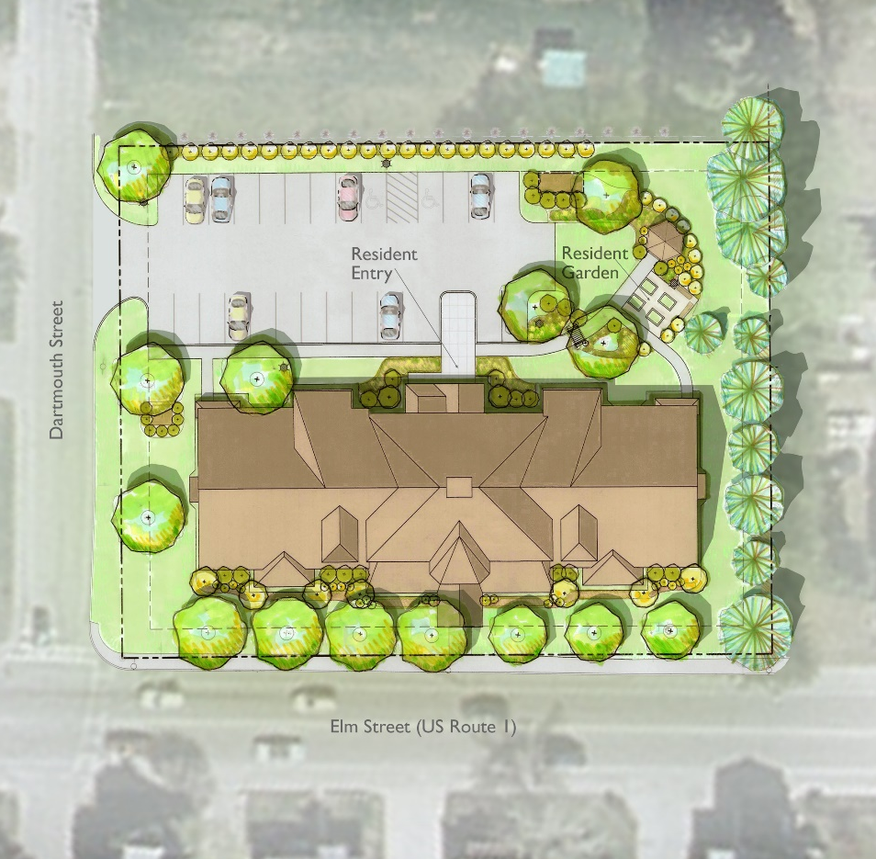
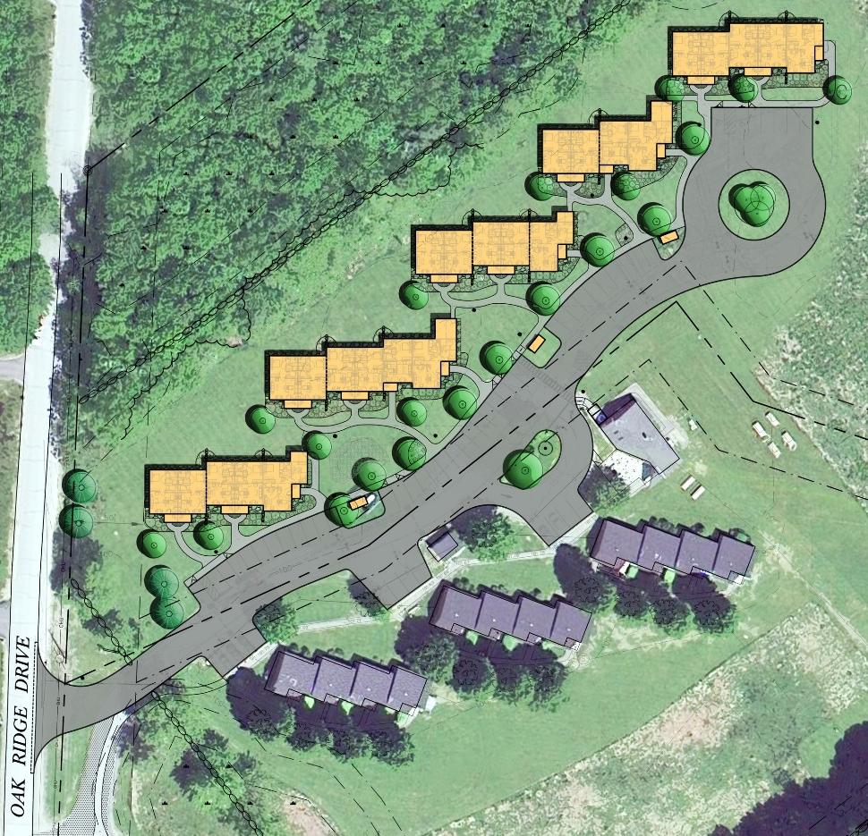
THE SITE
URBAN
RURAL

Slide 23
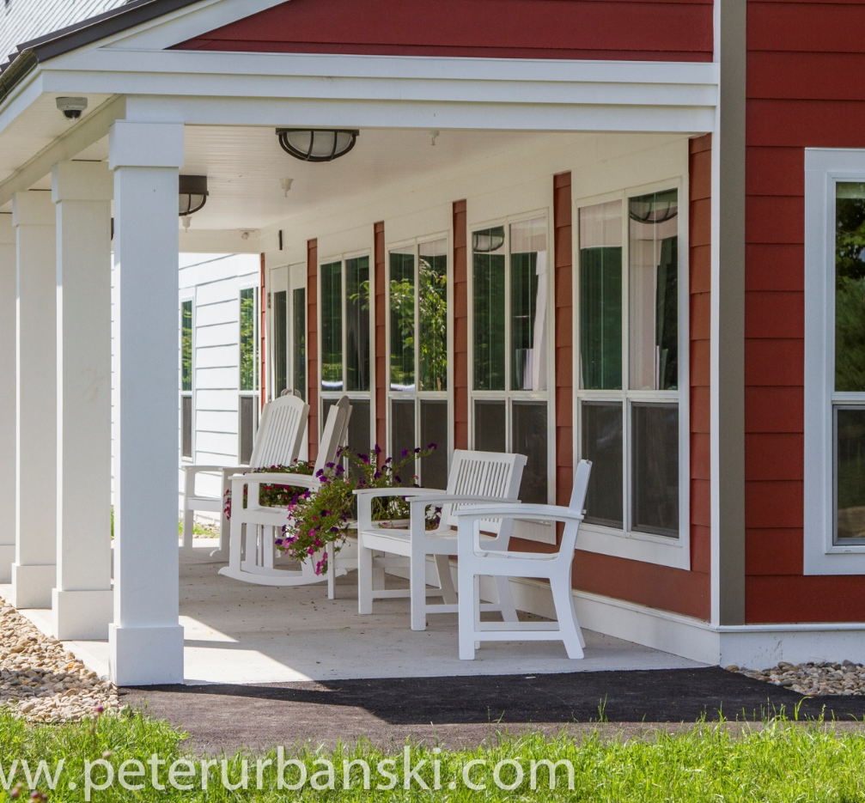
THE BUILDING
BUILDING CONCEPT
TRANSITION SPACES

Slide 24
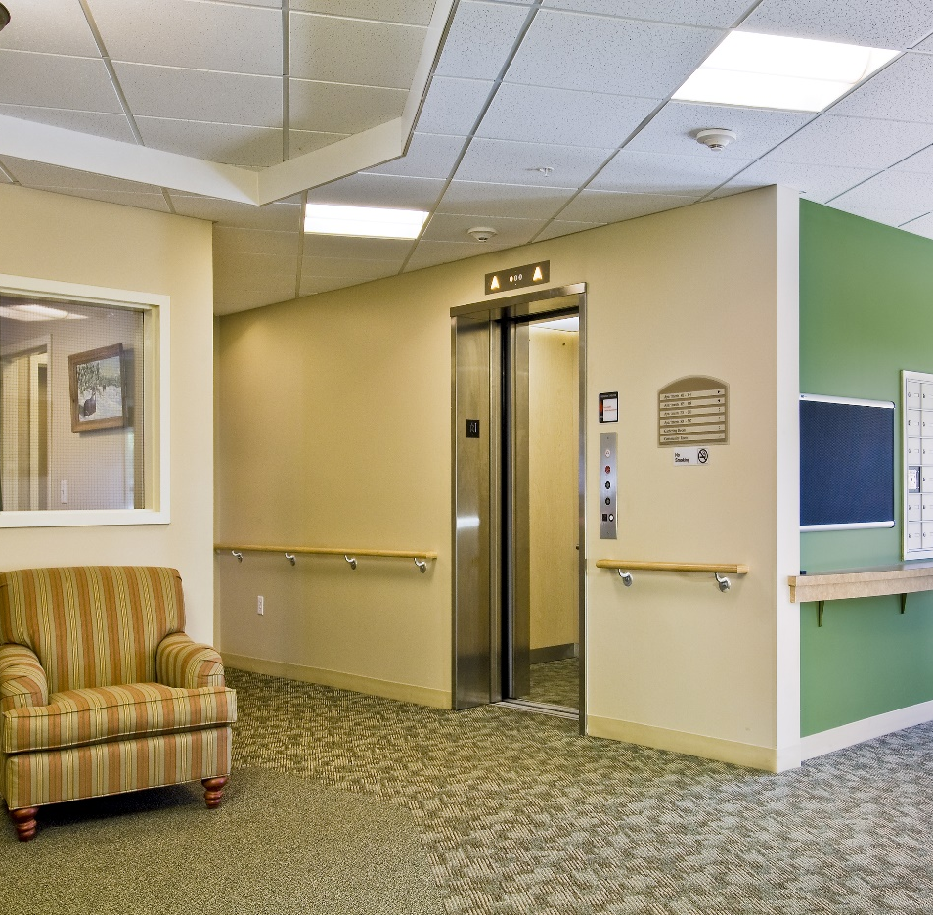
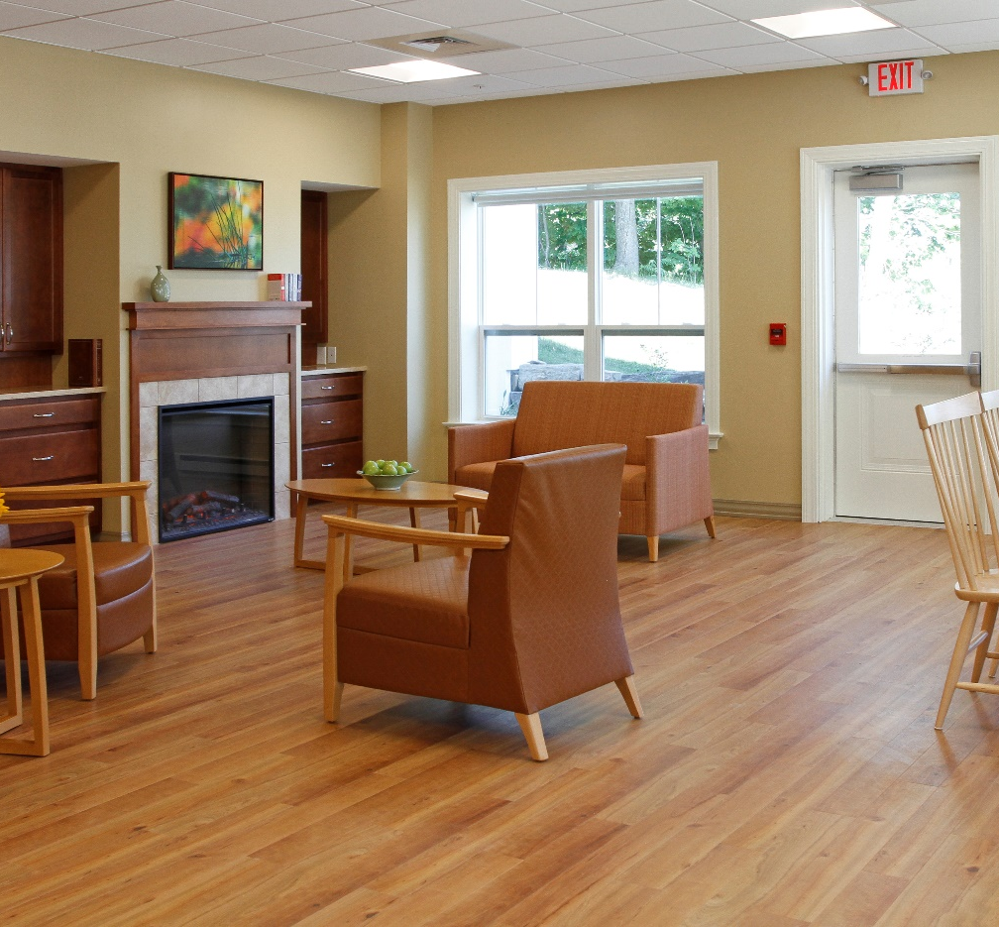
THE BUILDING
WAYFINDING
COMMUNITY SPACES

Slide 25
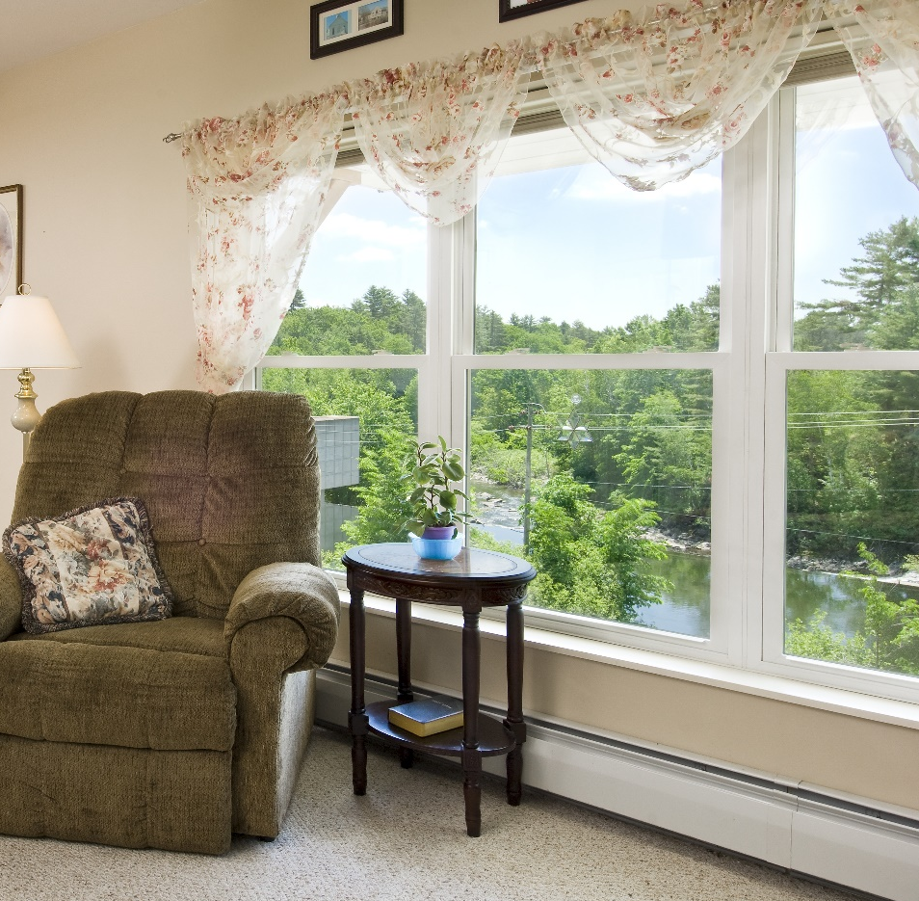
THE INTERIOR
NATURAL LIGHT
VIEWS

Slide 26
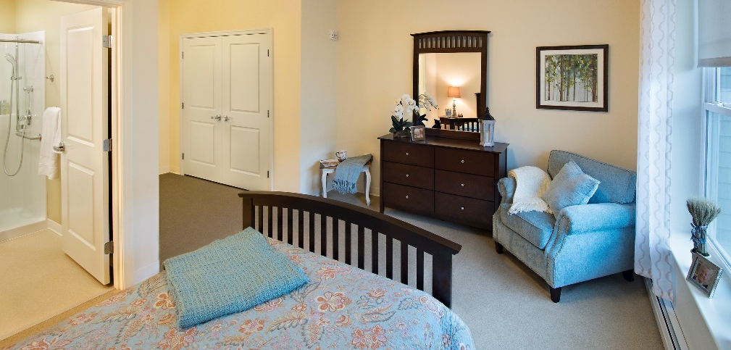
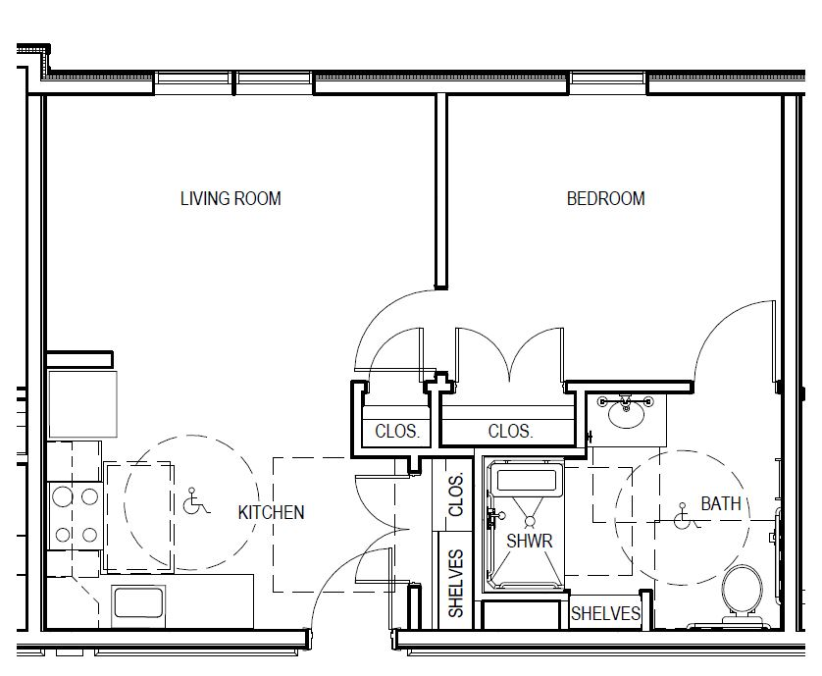
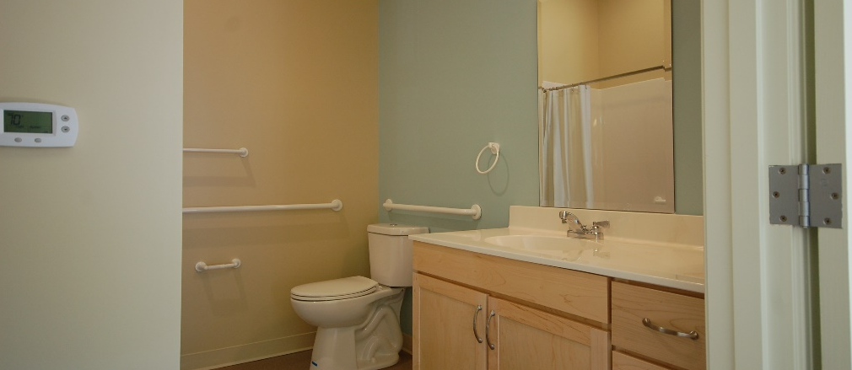
THE INTERIOR
INTERIOR FINISHES
APARTMENT LAYOUT
THE BATHROOM

Slide 28
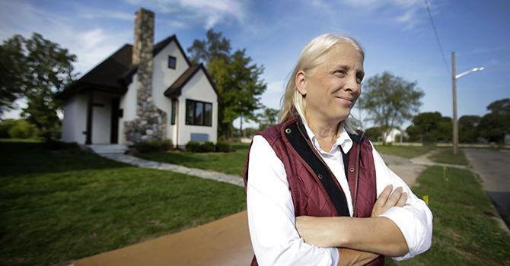
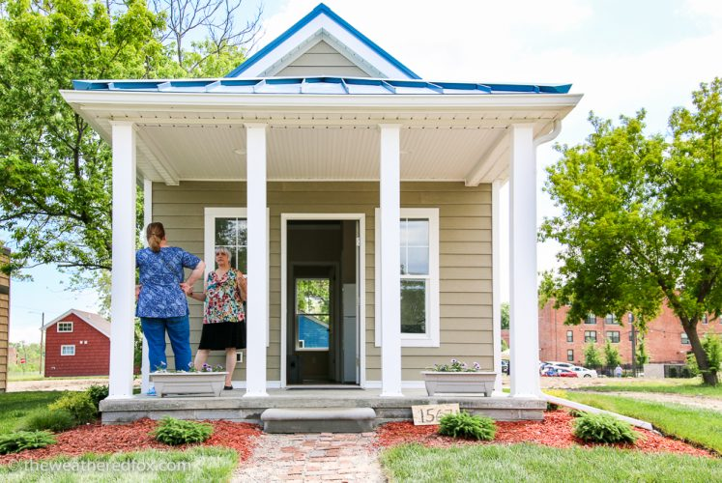

Slide 29
Q&A
To be unmuted
click here &
virtually raise your hand
Send questions to us by typing them in here.

Slide 30
Thank You for joining us!
Slides & evaluation will be
sent out later today.
Recorded webinar will be available
within 24 hours.
www.agefriendly.community
patriciafkimball@gmail.com
r

