Slide 1
Solving Transportation Problems
in Aging Rural America
Carol R. Wright
Co-Director, NADTC
Assistant Vice President
Transportation and Mobility
Easterseals, Inc.

Slide 2
Trending Topics in Rural Transportation for Older Adults & People with Disabilities 2017
Seamless Mobility & Mobility Management
Rural Travel Training
Succession Planning
Autonomous Vehicles & Their Technology
Accessible Bike Share Programs
Real-time Technology & Transit
ADA: Service Animals; Complaint Process; No Show Policies
Shared-Ride Services & How to Make It Work in Rural Settings
For more information on these and other topics, go to www.nadtc.org

Slide 3
Obstacles to Overcome in Solving Rural Transportation Issues
Low density population in rural areas
Long distances to travel to hubs for specialized medical care
Need for ongoing, regular transportation for dialysis, cancer treatment programs, etc.
High cost to provide service
Hard to find additional transportation service providers in the marketplace (Uber, Lyft, taxis, over-the-road long distance carriers such as Greyhound, Rimrock, Jefferson Lines, etc.)

Slide 4
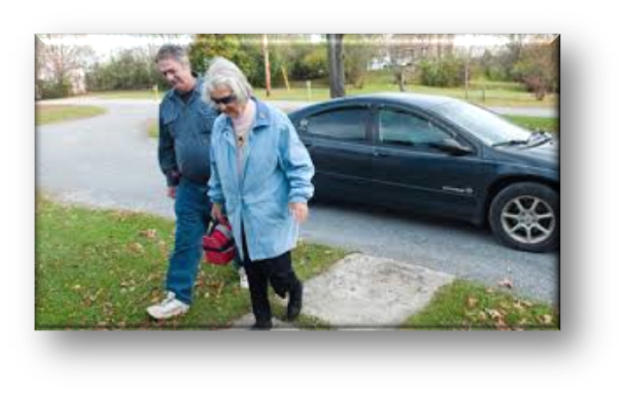
Volunteer Transportation Programs
Important option for meeting the needs of older adults and people with disabilities, especially in rural areas.
Allow individuals to access medical care, get groceries, attend community events, etc.
Can also provide needed 1:1 socialization for isolated, transit-dependent people.
Can be tailored to meet individual community needs.

Slide 5
Roles for Drivers within a Volunteer Transportation Program
Driver – Some volunteers use their own vehicle; others use an agency-owned vehicle.
Some programs go beyond providing curb-to-curb drop off service. Many offer door-through-door or hand-to-hand service.
Escort – Some volunteer driver programs allow the driver to assist at the destination by helping shop for groceries; carrying bags; going to the medical facility & waiting at the facility for the individual; etc.

Slide 6
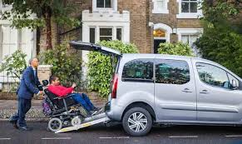
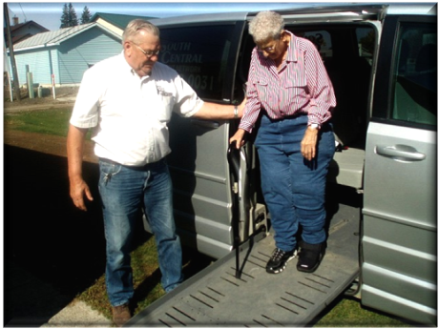
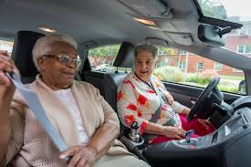
Volunteer Transportation Programs Vary
There is no “typical” volunteer transportation program. Many different models exist.
Volunteer transportation programs are important for filling gaps in public transportation or providing service where none is available.
Sample Volunteer Driver Programs

Slide 7
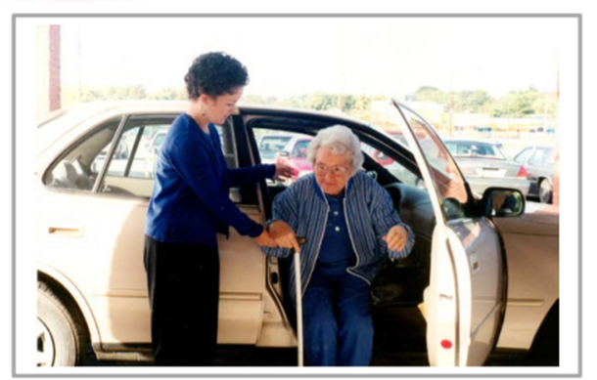
Examples of Volunteer Programs that Work!
Knoxville-Knox County Community Action Committee, Knoxville, TN - www.knoxseniors.org/vat
Use agency-owned hybrid sedans and wheelchair- accessible minivans
Volunteers are trained by agency
Provide door-through-door service
Cost: $3.00/one way ride; $6.00 roundtrip, with multiple stops permitted; out-of-county fares vary
Medical appointments; grocery shopping; prescription pickup; other appointments; social & recreational trips; anywhere in Knox County; out-of-county on a case-by-case basis

Slide 8
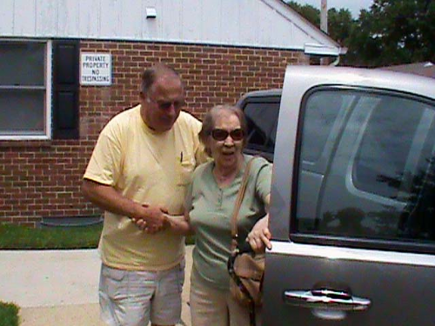
Volunteer Transportation Programs, continued
Partners in Care, Pasadena, MD – www.partnersincare.org
Volunteers use their own cars
Arm-in-arm service is available
Uses the concept of timebanking to support those who are aging in place in community (promotes active engagement of members and their families by offering services in exchange for their donated time and talents)
Provided more than 10,000 volunteer driver rides in 2016
Requests need to be made a week in advance
Rides provided at no cost to passengers
Volunteer Driver Assisting Passenger

Slide 9
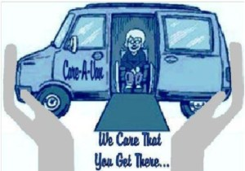
Volunteer Transportation Programs, continued
Rappahanock Rapidan Community Services Board/Area Agency on Aging, central Virginia – http://www.rrcsb.org
Care-A-Van provides door-to-door transit for healthcare & legal appointments for people with disabilities, RRCS clients, and older adults (60+).
Volunteer drivers use RRCS-supplied wheelchair-accessible vans.
No charge for service; donations are accepted.
Serves Culpeper, Fauquier, Madison, Orange, & Rappahannock Counties (crosses county lines)
Must reserve 48 business hours in advance

Slide 10
Volunteer Transportation Programs, continued
Mid-East Area Agency on Aging (MEAAA), Manchester, MO – https://agingmissouri.org
Senior Transportation and Rides (STAR) volunteer transportation program serves older adults (60+) in St. Charles County, Missouri; separate volunteer driver program for St. Louis County
Drivers use their own cars and can only take ambulatory passengers
Eligible passengers must be non-drivers or lack access to a vehicle and must be living independently in the community
Only available for medical appointments
Funded through a community block grant and the Older Americans Act
Drivers must have own insurance; secondary insurance provided by MEAAA
Drivers undergo training through MI DOT
Drivers must pass a background check

Slide 11
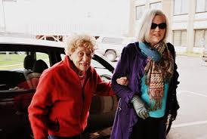
Recommendations for Starting a Volunteer Transportation Program
Research existing volunteer transportation models
Tailor the program to meet the needs of your community
Define who your program will serve
Determine service area
Investigate insurance options
Volunteer driver assisting older adult

Slide 12
Recommendations for Starting a Volunteer Transportation Program, continued
Seek community support (funding) to operate the program
Community Block Grants
United Way
Local Banks, Hospitals, larger companies who give to other community projects
Service Clubs
Casino Proceeds
Partnering with other Human Service Organizations

Slide 13
Recommendations for Starting a Volunteer Transportation Program, continued
Before starting the program & before recruiting volunteers, have policies & procedures in place that set expectations and define the volunteer’s role, rights and responsibilities.
Decide how you will recruit volunteers & be prepared to continue volunteer recruitment on an ongoing basis.
Conduct full-scale background checks on all volunteer drivers including driving records.
Volunteers should be trained and supervised the same as paid staff. You will need someone to be in charge.
Volunteer Drivers in Training

Slide 14
Recommendations for Starting a Volunteer Transportation Program, continued
Track data on your program. Know what it costs to operate and have data on rides, miles, destinations, outcomes for participants and drivers.
Conduct regular surveys of your riders and drivers to maintain regular feedback on how the program is performing so you can adjust and make changes as needed.
Contact NADTC and we will put you in touch with other existing programs across the country!

Slide 15
Carol R. Wright
Co-director, NADTC
Assistant Vice President, Transportation and Mobility
Easter Seals, Inc.
202.403.8365 | cwright@easterseals.com
www.nadtc.org

Slide 16
Resources
National Volunteer Transportation Center STAR Awards Programs
http://web1.ctaa.org/webmodules/webarticles/articlefiles/Promising_Practices_January_2015.pdf
Smith, Richard (2013) Risk, Liability and Loss Experience of Volunteer Driver Services: Is the Widespread Belief Warranted that Volunteer Driver Services are Inherently Risky? www.ilpconnect.org /wp-content/uploads/2013/06/Risk-Liability-Loss-Experience-in- Volunteer-Driver-Services_REPORT.pdf
ITN America – a membership organization that provides members access to arm-through-arm & door-through-door transportation services 24 hours a day, 7 days/week. www.itnamerica.org
TRIP Model – passengers recruit and arrange rides with their own driver who is then reimbursed for mileage. www.ilpconnect.org/triptrans

