Slide 1

NEW RULES FOR accessory dwellings
IN NEW HAMPSHIRE
Tri-State Learning Collaborative on Aging
Portland, Maine
November 28, 2017

Slide 2
Housing Needs & Preferences in NH
NH Center for Public Policy Studies 2014 reports: “Housing Needs and Preferences in New Hampshire”
  Slower population growth; aging population
  Mismatch of housing stock and needs and desires of changing population-young and old
  Older adults want to “age in place” or “age in community”

Slide 3
Expected Increase in Older Population
Source: NH Center for Public Policy Studies, 2014; “Housing Needs and Preferences in New Hampshire.”

Slide 4
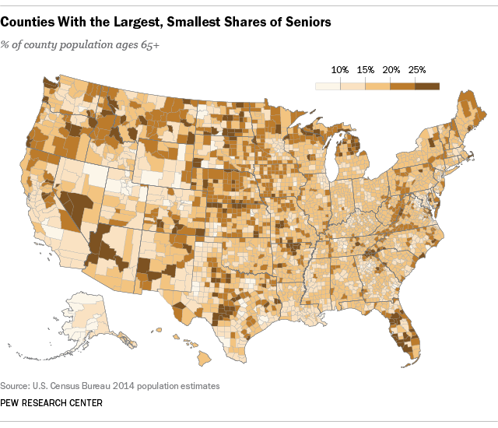
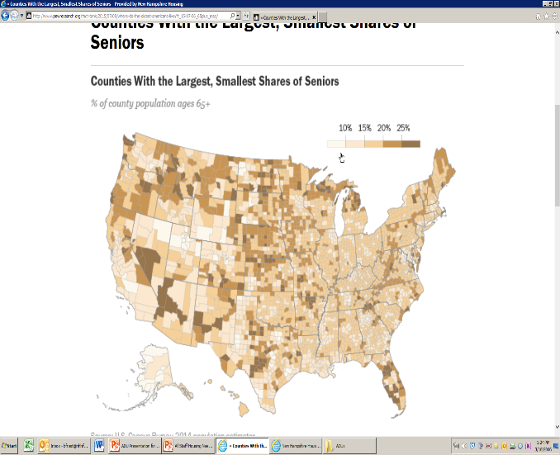
Median Age Belies Our Relative Youth
By this measure, the region is closer to the middle of the pack
2016 Median Age
1. Maine 44.6
2. NH 43.0
3. Vermont 42.7
4. W. Virginia 42.2
5. Florida 42.1
…
Utah 30.8
American Community Survey
Notes:
NH 2000 median was 37.1
Vermont was 37.7
Maine was 38.6
Utah was 27.1
Lincoln County, ME: Boothbay, Wiscasset
https://www.census.gov/newsroom/press-releases/2017/cb17-100.html

Slide 5
What Does It Mean?
What are the housing implications of these demographic changes?
  We need to house an aging population
  We need to attract and retain a younger workforce
What are the policy implications of these demographic changes?
Do these different populations want the same (or similar) things?
Notes:
Who will win in fair and open competition? (“Follow the money…”)

Slide 6
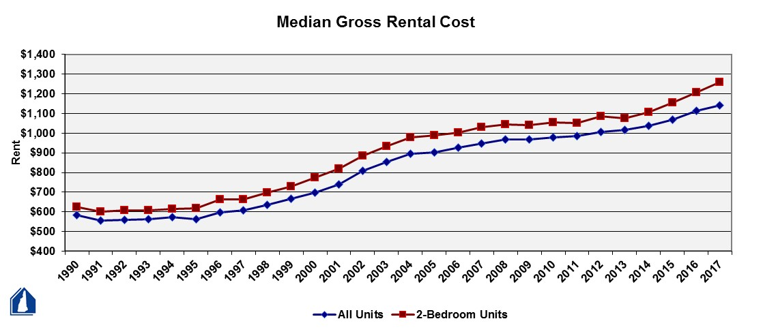
Rents in NH: Up, Up, Up

Slide 7
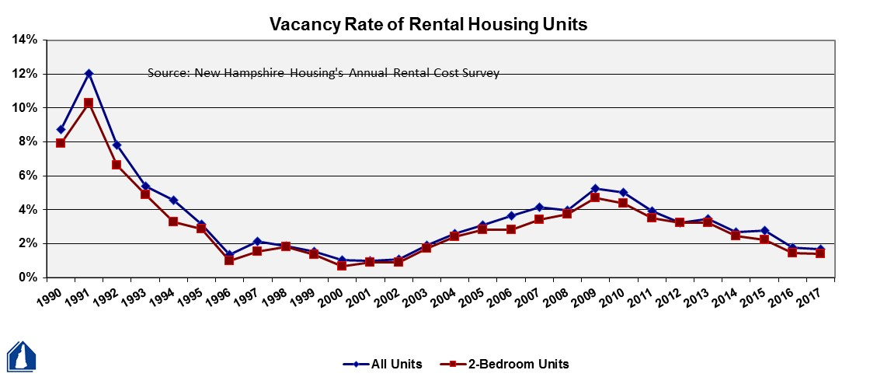
NH Vacancy Rate: Down, Down, Down
2017: 1.7%

Slide 8
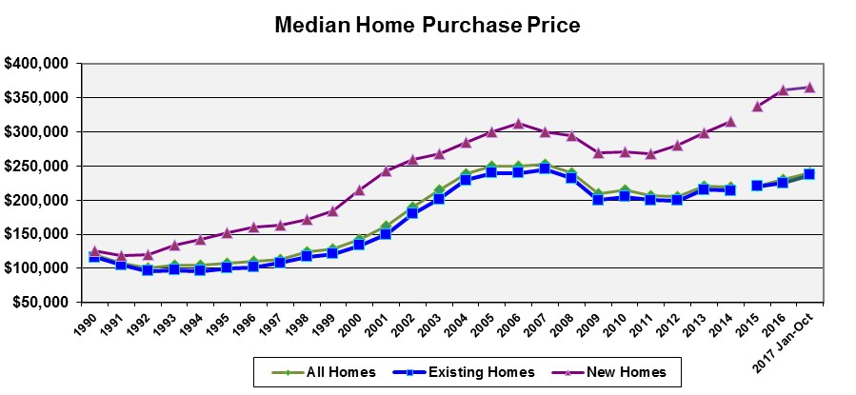
NH Home Prices Have Recovered

Slide 9
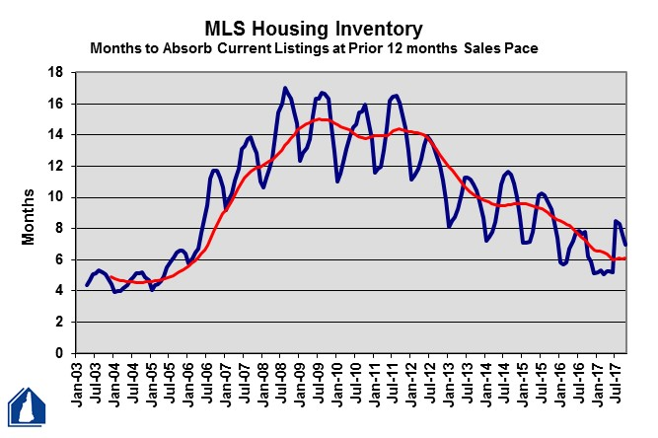
But NH Inventory Is Plummeting

Slide 10
ADUs – What Are They?
A second, smaller dwelling on the same grounds as a single-family house – attached or detached
  An apartment over the garage, in the basement, in an outbuilding
  Also called granny flats, in-law apartments, family apartments, or secondary units
“Accessory” is a word that has meaning – customarily incidental and subordinate to the primary use

Slide 11
Benefits of ADUs
Increases a community’s housing supply without further land development
Facilitates efficient use of existing housing stock & infrastructure
An affordable housing option for many low- and moderate-income residents
Improves homeowner cash flow
Helpful to elderly and/or disabled people who may want to live close to family members
  or caregivers, empty nesters, young adults, etc.

Slide 12
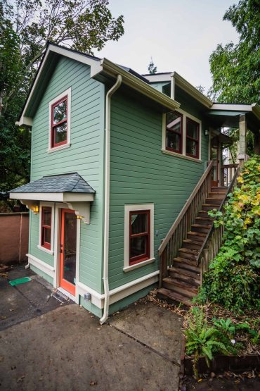
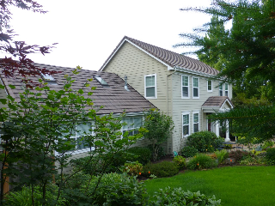
ADUs – Out West
Bob Harris
www.accessorydwellings.org
ADUs in Eugene and Portland, OR
Barbara Gundle
www.accessorydwellings.org
Notes:
Neighborhood: Hawkins View, Eugene, OR
Type: addition to primary dwelling
Anticipated Use: owner’s mother’s primary residence
Square Footage: 785
Year Built: 2007
Owner: Bob Harris
Total Cost: $170,000 (construction included remodel and landscaping of main house, redesign of deck, and new appliances so it is difficult to split out the cost of the SDU)
Neighborhood: Irvington, Portland, OR
Type: detached garage conversion
Use: short-term rental
Square Footage: 440
Year Built: 1991
Conversion Year: 2015
Owners: Barbara Gundle
Total Cost: $160,000

Slide 13
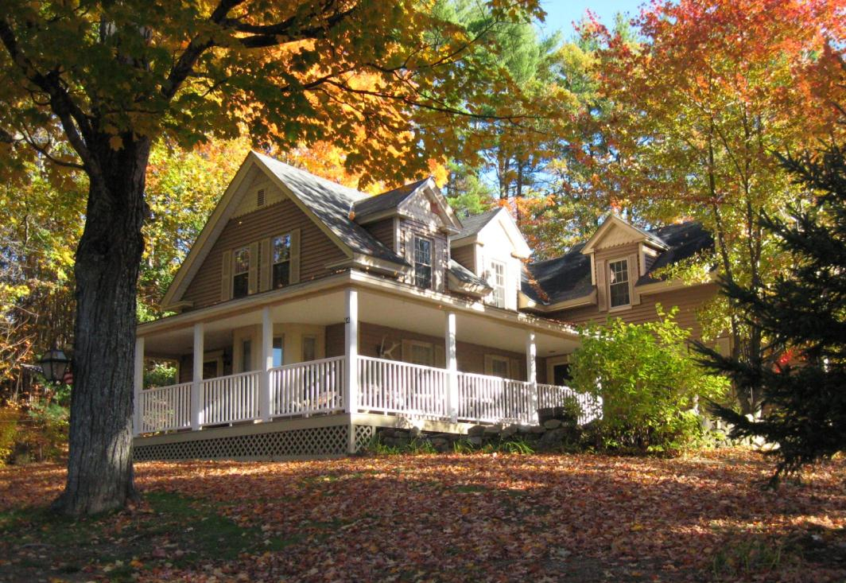
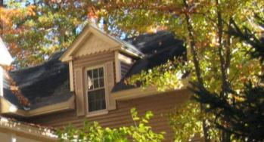
ADUs – Close to Home
Find the hidden ADU in Warner, New Hampshire

Slide 14
NH ADU Law’s “Back Story”
Demographic and market changes
Homebuilders unable to fulfill homeowner requests to create ADUs for a family member or caregiver
  Stymied by local land use restrictions
  Sought legislative relief

Slide 15
NH ADU Law – The Basics
Defining Characteristics
  Independent living unit (sleeping, cooking, eating, sanitation)
  Adequate water supply and sewage disposal required
  Interior door between primary unit and ADU required
Municipal Role
  Municipalities must allow an attached ADU in any single-family zone by right, special exception, or conditional use permit
  If the zoning ordinance is silent on ADUs, then they are allowed in any single-family home (regardless of zone)
  Standards for a single-family home also apply to combined SF and ADU (e.g., setbacks and frontage)

Slide 16
NH ADU Law – Options
Municipality may
  Require adequate parking to accommodate an ADU
  Require owner occupancy of one of the units (but can’t say which one)
  Require demonstration that a unit is the owner’s principal place of residence
  Control for architectural appearance (“look and feel”)
  Limit the number of ADUs per single family dwelling
  Limit the number of unrelated individuals that occupy a single unit (concern of college towns)

Slide 17
NH ADU Law – Prohibitions
Municipality must not
  Limit ADU to 1 bedroom
  Require minimum size to be less than 750 s.f.
  Require a familial relationship between the occupants of principal dwelling and ADU
  Require the interior door between primary unit and ADU to remain unlocked
  Require additional lot area or other dimensional standards for ADU (but it may increase lot size for a detached ADU)

Slide 18
How Did This Happen?
“The House Built on Trust”
Years of advocacy
Development of collaborative relationships
  NH Business and Industry Association
  NH Home Builders, NH Realtors, AARP
  NH Municipal Association
  Communities of advocates
Strike when opportunity presents

Slide 19

Questions?
Ben Frost
bfrost@nhhfa.org
George Reagan
greagan@nhhfa.org

