Slide 1
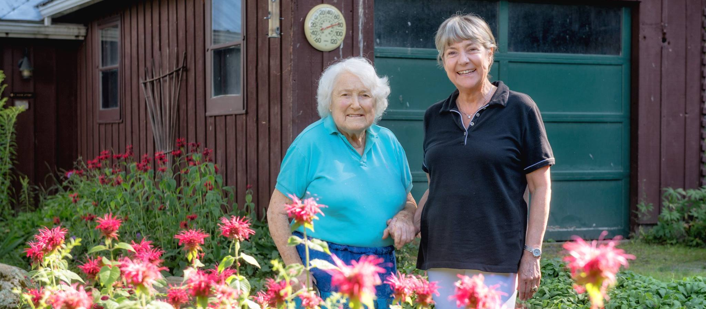
Today’s Webinar:
Creative Ways to Age at Home by Sharing One’s Home

Slide 2
Tri-State Learning Collaborative on Aging
Increasing the collective impact of aging in place initiatives through shared learning.
www.agefriendly.community

Slide 3
Tri-State Learning Collaborative on Aging
www.agefriendly.community

Slide 4
tamekiasj@gmail.com
Webinar Housekeeping
Audio issues?
Try calling in using your telephone!
To be unmuted
click here &
virtually raise your hand
Send questions to us by typing them in here.

Slide 5
Upcoming Learning Opportunities
General Interest Webinar Series:
August 16th: Getting Outside and Getting Moving
September 14th: Combatting Social Isolation
Community Leaders Webinar Series:
August 22nd: Tools of the Age-Friendly Trade
September 26th: Getting the most out of
your Community Leaders Forum

Slide 6
Goal of Webinar
Today’s Presenters

Slide 8
Would you like to have a program that:
Offers an average rent of $221/month
Helps people ages 18-99+
Helps people of any income but mostly with very low incomes
Participants report feeling safer, healthier, and sleeping & eating better.
It’s called homesharing!

Slide 9
Would you like to have a program that:
Offers an average rent of $221/month
Helps people ages 18-99+
Helps people of any income but mostly with very low incomes
Participants report feeling safer, healthier, and sleeping & eating better.
It’s called homesharing!
Watch this short video:
https://youtu.be/XnPBe6CG9SI

Slide 10
Would you like to have a program that:
Offers an average rent of $221/month
Helps people ages 18-99+
Helps people of any income but mostly with very low incomes
Participants report feeling safer, healthier, and sleeping & eating better.
It’s called homesharing!

Slide 11
What is homesharing?
Two or more people share a home to their mutual benefit. (Hosts & Guests)
The home can be an apartment, condo, mobile home, or traditional single family house.
The Host offers a private bedroom and shared common area in exchange for rent, service, or a combination of the two.
It differs from a typical roommate situation because it is about two people helping each other.
There is usually a written agreement outlining the expectations of both parties.
A non-profit homesharing organization generally provides screening, matching, and ongoing support.
Notes:
Every homesharing arrangement is unique, depending on the needs, time, and abilities of the people involved.

Slide 12
What Homesharing Is Not
Personal care such as bathing, toileting, or dressing assistance is not part of the service exchange.
Hosts must be relatively independent with no expectation that the Guest is available 24/7.
It is not an alternative to nursing home care although it can be one service, in combination with others that could prevent or delay nursing home placement.
Notes:
Service can include meal preparation, yard work, walking the dog or computer help just to name a few.

Slide 13
Community Benefits of Homesharing
Helps seniors age in place
Helps people with disabilities be more independent
Helps low and moderate income people maintain or find very affordable housing
Provides incredibly cost effective housing program using existing housing stock

Slide 14
Individual Benefits of Homesharing: Health and Independence
2016 Survey results of those sharing their home reported:
85% feel safer in their home
82% feel happier
77% feel less lonely
69% report household chores are completed more regularly
64% sleep better
59% eat better
56% feel healthier
54% call family less often for help
46% get out into the community more often
44% worry less about money

Slide 15
FY 16 Other Benefits to Individuals and Community:
Very affordable housing
Average rent of all homesharing matches was $221/month
Of the total matches 30% were no-rent exchanges, just service.
We serve all ages!
This year our homeshare hosts ranged in age from 27-99 with the average being 68.
Our homeshare guests ranged in age from 23-71 with the average being 46.
Service to our neighbors
Those who found housing through HomeShare Vermont provided approximately 26,000 hours of assistance to our neighbors
Supplemental income
By sharing their homes, low-income seniors and others received over $111,000 in rental income to help make ends meet.

Slide 16
Screening and Matching Process
FY 16 we:
processed 364 applications
made over 1,000 reference checks
performed over 1,500 background checks
interviewed 253 new customers (many in their homes)
facilitated 99 in-home introductions
supported or created 77 homesharing
matches

Slide 17
Components of a Successful Program
The report “Strategies for Scaling Shared Housing” highlighted 10 critical components which homesharing programs should include:
Screening Process (most important)
Written Homeshare Agreements
Trial Periods Preceding a Match
Ongoing Monitoring
Adequate Staffing Levels
Data Collection
Risk Management
Fair Housing Compliance
Complementary Alliances, and
Volunteer Support

Slide 18
Where does Homesharing work best?
For a homesharing program to succeed you need to have two groups of people: those looking for housing and those with a home with an extra bedroom.
Homesharing programs work best in areas where housing is expensive
There is a shortage of affordable housing
and it’s a place where people want to live: near jobs, schools and transportation

Slide 19
Resources:
www.HomeShareVermont.org - DIY Manual for individuals to host
www.NationalSharedHousing.org - online state by state directory of programs
National homesharing conference September 2018 in CA
Program start-up guide to be available in January 2018

Slide 20
NEW (Hampshire) RULES FOR accessory dwellings
Tri-State Learning Collaborative on Aging
July 25, 2017

Slide 21
ADUs – What Are They?
A second, smaller dwelling on the same grounds as a single-family house – attached or detached
An apartment over the garage, in the basement, in an outbuilding
Also called granny flats, in-law apartments, family apartments, or secondary units
“Accessory” is a word that has meaning – customarily incidental and subordinate to the primary use

Slide 22
Benefits of ADUs
Increases a community’s housing supply without further land development
Facilitates efficient use of existing housing stock & infrastructure
An affordable housing option for many low- and moderate-income residents
Improves homeowner cash flow
Helpful to elderly and/or disabled people who may want to live close to family members
or for caregivers, empty nesters, young adults, etc.

Slide 23
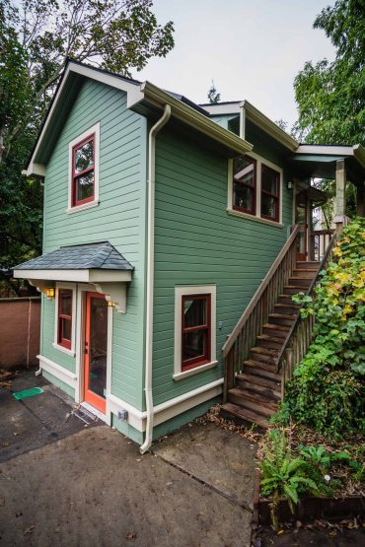
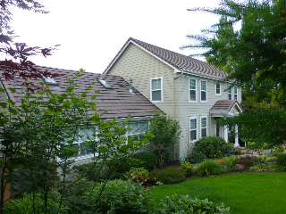
ADUs – Out West
Bob Harris
www.accessorydwellings.org
ADUs in Eugene and Portland, OR
Barbara Gundle
www.accessorydwellings.org
Notes:
Neighborhood: Hawkins View, Eugene, OR
Type: addition to primary dwelling
Anticipated Use: owner’s mother’s primary residence
Square Footage: 785
Year Built: 2007
Owner: Bob Harris
Total Cost: $170,000 (construction included remodel and landscaping of main house, resdesign of deck, and new appliances so it is difficult to split out the cost of the SDU)
Neighborhood: Irvington, Portland, OR
Type: detached garage conversion
Use: short-term rental
Square Footage: 440
Year Built: 1991
Conversion Year: 2015
Owners: Barbara Gundle
Total Cost: $160,000

Slide 24
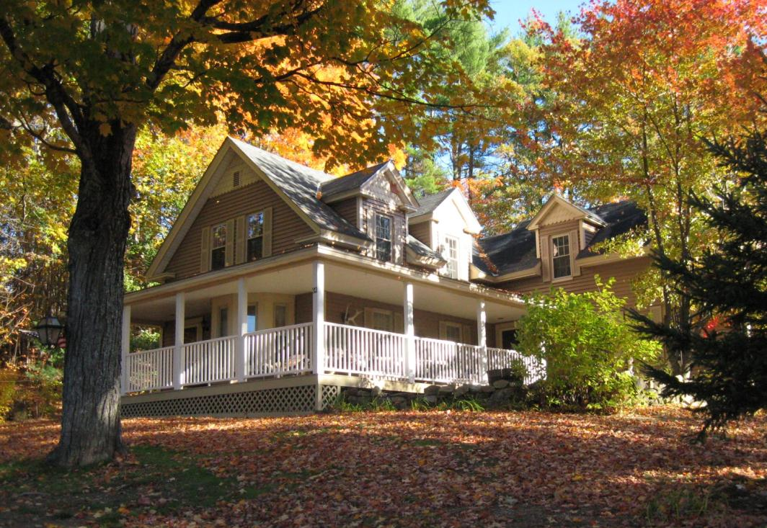
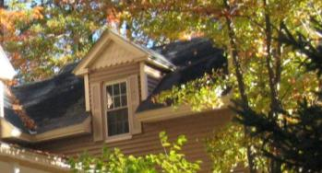
ADUs – Closer to Home
Find the hidden ADU in Warner, New Hampshire

Slide 25
ADUs – History and Evolution
Early 20th century – a common feature in SF homes
With post-WWII suburbanization and deployment of “Euclidean” zoning, ADUs became far less prevalent
Baby boom/Car boom/Sprawl
Less interest in efficient use of space
Easier mortgage financing
But things are changing…
Notes:
Village of Euclid OH v. Ambler Realty

Slide 26
Housing Needs and Preferences
NH Center for Public Policy Studies 2014 reports: “Housing Needs and Preferences in New Hampshire”
Slower population growth; aging population
Mismatch of housing stock and needs and desires of changing population-young and old
Older adults want to “age in place” or “age in community”

Slide 27
What Does It Mean?
What are the housing implications of these demographic changes?
We need to house an aging population
We need to attract and retain a younger workforce
Do these different populations want the same (or similar) things?
Who will win in a bidders’ war?
Notes:
Who will win in fair and open competition? (“Follow the money…”)

Slide 28
Better Living in Less Space?
https://makespace.com/blog/posts/carmel-place-nyc-micro-apartment-building-kips-bay/

Slide 29
NH ADU Law’s “Back Story”
Demographic and market changes
Homebuilders unable to fulfill homeowner requests to create ADUs for a family member or caregiver
Stymied by local land use restrictions
Sought legislative relief

Slide 30
NH ADU Law – The Basics
Municipal Role
Municipalities must allow an attached ADU in any single-family zone by right, special exception, or conditional use permit
If the zoning ordinance is silent on ADUs, then they are allowed in any single-family home (regardless of zone)
Standards for a single-family home also apply to combined SF and ADU (e.g., setbacks and frontage)
Defining Characteristics of ADUs Under NH Law
Independent living unit (sleeping, cooking, eating, sanitation)
Adequate water supply and sewage disposal required
Interior door between primary unit and ADU required

Slide 31
NH ADU Law – Options
Municipality may
Require adequate parking to accommodate an ADU
Require owner occupancy of one of the units (but can’t say which one) and require it to be owner’s principal place of residence
Control for architectural appearance (“look and feel”)
Limit the number of ADUs per single family dwelling
Limit the number of unrelated individuals that occupy a single unit (concern of college towns)
Allow detached ADUs

Slide 32
NH ADU Law – Prohibitions
Municipality must not
Limit ADU to 1 bedroom
Require minimum size to be less than 750 s.f.
Require a familial relationship between the occupants of principal dwelling and ADU
Require the interior door between primary unit and ADU to remain unlocked
Require additional lot area or other dimensional standards for ADU (but it may increase lot size for a detached ADU)

Slide 33
NH ADU Law – What Next?
Effective date: June 1, 2017
Many communities responded at 2017 town meeting
Bills passed this year to
Prevent owners from being required to install a new septic system (but a new design can be required)
To prohibit condo conversion of ADUs, and allow municipalities to limit ADUs in townhouses and manufactured housing
New Hampshire Housing will publish an ADU guidebook later this year

Slide 34
NH ADU Law – FAQs
Isn’t this just a duplex?
Do we still need to care about workforce housing?
Do impact fees apply to a new ADU?
What does “attached” mean?
What’s the purpose of an interior door?
What about DES septic standards?
Can HO associations or condo docs prohibit ADUs?
Owner occupancy – what if the owner is a trust?
What are the HUD occupancy standards?
What about use as a short-term rental?
What if we do nothing?

Slide 35
Questions?
Ben Frost
bfrost@nhhfa.org
George Reagan
greagan@nhhfa.org
New Hampshire Housing's mission is to promote, finance and support affordable housing and related services for the people of New Hampshire.
Although established by statute as a public instrumentality, New Hampshire Housing is not a state agency and receives no operating funds from the state government.

Slide 36
Accessory Dwelling Units in Portland, Maine
Creative Ways to Age at Home by Sharing One’s Home
Tri-State Learning Collaborative on Aging
July 25 2017

Slide 37
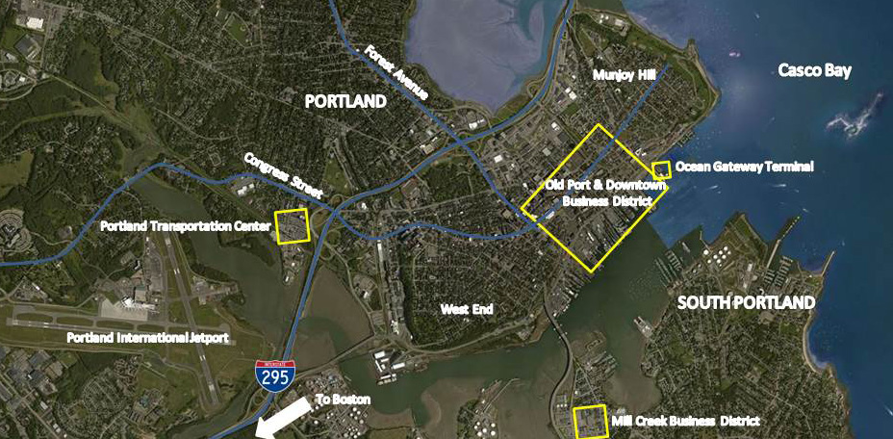
Portland, ME

Slide 38
Portland, ME
Economic and cultural center of Maine and much of Northern New England
Urban place in a rural state
Attracts residents from “away” (Brooklyn, Boston, Chicago) for high quality of life and accessible scale
At the same time, Portland natives want to stay
Demand for both aging in place and relocating retirees to find places to live
Home owners seeking ways to help pay for their homes

Slide 39
Portland, ME
Population: 67,000, largest municipality in Maine
Population Growth 3% (2000-2010)
Race: 83% White; and, 17% non-White
Education: Over 44% with Bachelor Degree or more
Portland MSA Population: 514,098
Diversity – Over 60 Languages spoken in Portland Schools
Unemployment Rate: 3.3% in 2015 - down from 4% in 2014
Diversified Tax Base: 44% Commercial/Industrial; 56% Residential

Slide 40
Portland’s Plan 2030
Recently completed Comprehensive Plan for the city
Sets growth target of 72,000 residents by 2030 (from 67,000)
Focus on growth along commercial corridors & nodes
Equitable, inclusive and sustainable growth seen as important
Aging in Place is identified as a goal:
“Support Aging in Place”
“Create, promote, and facilitate safe, affordable, and practical housing solutions that will meet the evolving needs of Portland residents as they age.”
“Support Age-Friendly Initiatives” in transportation

Slide 41
Accessory Dwelling Units – History
Regulations to allow the conversion of a single family home to accommodate one accessory unit were adopted in the mid-1980’s –at the time with some age restrictions
Between that time and 2005, 28 ADU’s were approved by the City out of 33 applications
In 2005 amendments to the ordinance relaxed some standards and eliminated age limitations
In 2015 additional amendments were approved to (1) further allow ADU’s in traditional neighborhoods such as Deering Center and East Deering and (2) expand ADU’s allowed on Peaks Island
These 2015 changes set maximum income levels for residents of these expanded ADU’s – to preserve them for low-income and elderly residents

Slide 42
Accessory Dwelling Units - Questions
How are they different from a second (or third) dwelling unit? In some zones the multi-family nature resolves the question.
Who are they for? How do we keep them from become Short Term Rentals without being too restrictive?
Isn’t this a way of increasing density and not addressing impacts?
Portland currently answers these questions differently in different locations.

Slide 43
Accessory Dwelling Units – R-3 Zone
R-3 Zone
Mostly a single family zone, farther out from downtown
Smaller homes on slightly larger lots
Must be reviewed by the Planning Board
No more than 30% of the overall building size and no less than 400 square feet in size
Must maintain architecture of main building
Lot must be at least 6,500 sf.
Must have owner-occupant in one unit
Must provide parking (generally one more parking space)

Slide 44
Accessory Dwelling Units – R-5 Zone
R-5 Zone
Traditional “streetcar suburbs” closer to downtown. Walkable to local services
Mix of single- and multi-family dwellings
Very attractive zone for aging in place
Allows “use of space existing as of 9/3/08” for additional units by Planning Board review
Cannot be sold as condos
Occupants must be low-income
Must be at least 400 sf. and only minimally impact primary units
Design impacts on building must be minimal
Must provide parking

Slide 45
Accessory Dwelling Units – Peaks Island
Peaks Island
Island neighborhood with good ferry access to downtown
Highly seasonal population swing
Goal is to allow year-round residents to have options
Allows ADU’s of 400 sf. or more, no more than 35% of the total size of building
Design must preserve character of house
Owner must live in one of the units (main house or ADU)
No sale as condo/short term rentals
Resident must be of moderate- or low-income

Slide 46
Zoning Changes are not for the Faint of Heart!
Process is time consuming and brings out concerned residents
Often the worst is assumed
Education is important
Don’t give in to allowing too many restrictions, will not be used
May not succeed first time, be persistent
Listen to those who want to create ADU’s and balance that with neighborhood concerns
A well drafted ordinance means ADU’s with minimal neighborhood impact
Not a panacea, either!

Slide 47
CONTACT INFORMATION
Jeff Levine
Planning & Urban Development
207-874-8430
jlevine@portlandmaine.gov
@portlandplan

Slide 48
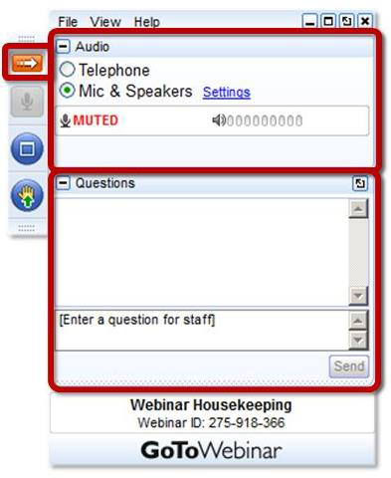
Q&A:
To be unmuted, click here and virtually raise your hand.
Send questions to us by typing them in here.

Slide 49
Thank You for joining us!
Slides & evaluation will be sent out later today.
Recorded webinar will be available within 24 hours.
www.agefriendly.community
patriciafkimball@gmail.com
r

